Slide 1

Personal Finance for the Military Physician: A 2022 Update
Joel Schofer, MD, MBA, CPE
CAPT, MC, USN
Deputy Chief, Medical Corps

Slide 2
Military Disclaimer
The views expressed in this presentation are those of the author and do not necessarily reflect the official policy or position of the Department of the Navy, Department of Defense, or the United States Government.

Slide 3

Why Am I Speaking About This?

Slide 4

I Paid Myself Every Month

Slide 5
I Lived a Reasonable Lifestyle
Cars I’ve Owned
Housing Expenses
Honda CRV
VW Jetta
Okinawa beater #1 (used)
Okinawa beater #2 (used)
Toyota Matrix (used)
Ford Fusion Hybrid
Toyota Prius
Toyota Sienna (used)
Honda Fit
Chevy Cruze (FREE)
2 BR apartment (1 kid)
$390K townhouse
4 BR rental house (2 kids)
3 BR apartment
Base housing
$395K house
4 BR rental house
$407K house
AirBnB room

Slide 6
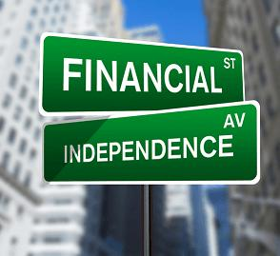
Financially Independent

Slide 7
Let’s Get You to the Same Place

Slide 8



Step 1 – Track Your Finances

Slide 9
Step 2 – Get Properly Insured
Insurance you probably need
  Supplemental disability insurance
  Umbrella liability insurance – “enough” coverage but at least $1M
Insurance you might need
  Term life insurance – do not buy whole life insurance
    https://www.whitecoatinvestor.com/what-you-need-to-know-about-whole-life-insurance/
  Moonlighting malpractice insurance

Slide 10


Where Can You Get Disability Insurance?
DI4MDs.com
Physician Financial Services
Often cheaper if purchased during GME training
Often can’t purchase if OCONUS

Slide 11


Moonlighting Malpractice Insurance
Claims-Made
Occurrence

Slide 12
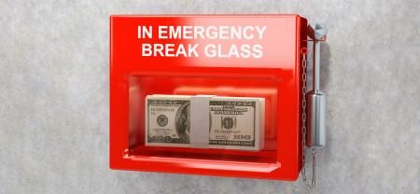
Step 3 – Establish an Emergency Fund
3-6 months of living EXPENSES (NOT INCOME)
  High-yield savings or money market account
    Bankrate.com to find highest rate
  Money market fund
    Tax-free if in higher tax bracket

Slide 13

Step 4 – Manage Your Debt
Never carry a credit card balance
Borrow only for appreciating assets (real estate, education, businesses)
  Not cars
Be debt free by retirement
Get smart about student loans if you have them

Slide 14


Student Loans
StudentLoanAdvice.com
StudentLoanPlanner.com

Slide 15
Step 5 - Max Out Your Retirement Accounts
Goal – save 20% of your gross/pre-tax income for retirement
Thrift Savings Plan - $20,500 in 2022 (+$6,500 if > 50)
  Combat zone tax exclusion
    https://mccareer.org/2017/07/09/guest-post-maximizing-tsp-contributions-during-deployment/
IRA - $6,000 in 2022 (+$1,000 if > 50)
  Roth phased out at $129K single, $204K married
  Backdoor Roth IRA - http://whitecoatinvestor.com/backdoor-roth-ira-tutorial/
Rest goes in taxable brokerage accounts

Slide 16
Extra Retirement Accounts for Independent Contract Moonlighters
Receive a 1099 tax form - not W2 (employee)
  SEP IRA or solo 401k – up to $61,000 in 2022 ($67,500 if over 50)
    Rare that you’ll hit these maximums because can’t earn enough
  SEP IRA easier to set up than solo 401k but messes up your Backdoor Roth IRA due to the pro rata rule
    https://www.whitecoatinvestor.com/17-ways-to-screw-up-a-backdoor-roth-ira/
  Solo 401k allows more money to be contributed at equivalent salary
  http://whitecoatinvestor.com/sep-ira-vs-solo-401k/
Incorporating offers no liability protection

Slide 17
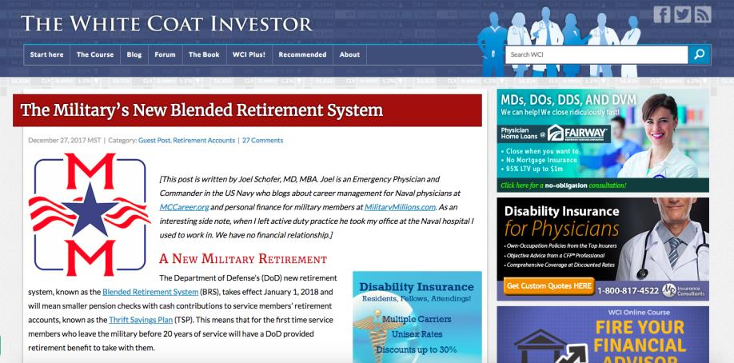
Blended Retirement System
Get the match (free money)
Contribute every month
Don’t fill TSP too early
(https://www.whitecoatinvestor.com/the-militarys-new-blended-retirement-system/)

Slide 18
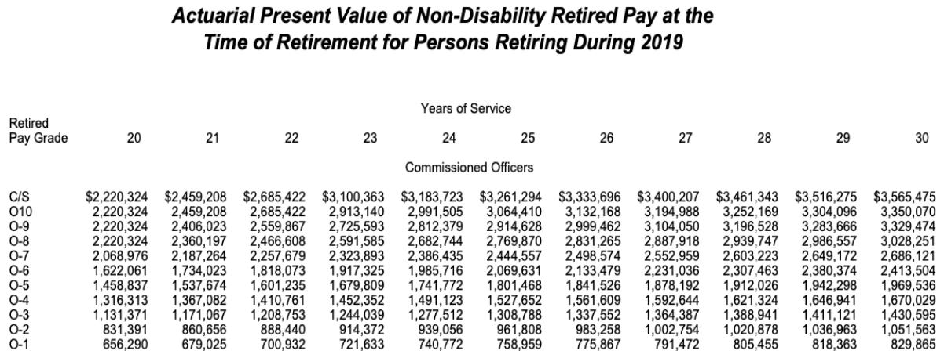
Value of a Military Pension
Numbers above represent how much money you’d need today to equal the pension
  20 year O5 - $1.46 million
  21 year O6 - $1.73 million
(https://mccareer.org/2019/10/03/throwback-thursday-classic-post-how-valuable-is-a-military-pension/)

Slide 19
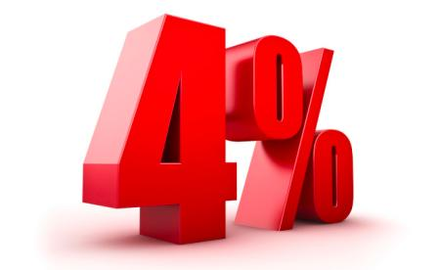
How Do You Know When You Have Enough?
The 4% rule
Example:
  Want $120k/year during retirement
  $60K/year pension
  Means I need $60K in additional income
  $60K/0.04 = $1.5 million

Slide 20

Step 6 - Invest in Stock & Bond Index Funds or ETFs
Must invest in stocks and bonds to beat inflation
  Low bond yields may not keep up with inflation
Mutual funds or exchange traded funds (ETFs)
  Not individual stocks/bonds
Index funds beat actively managed funds

Slide 21
Index Funds vs Active Management
Index Funds
Active Management
Buy and hold a bunch of stocks or bonds in an index
Common types of index funds include (TSP equivalents):
  S&P 500 Stocks (C Fund)
  Total US Stock Market (C + S Fund 3:1 ratio)
  Total International Stock Market (no TSP equivalent yet)
  Total US Bond Market (F Fund)
  Etc.
Fund managers try to beat their comparative index
Buy and sell in order to do so
This generates fees and taxes for investors in the fund, which increases fund expenses

Slide 22

You Can’t Control the Market

Slide 23


What You Can Control

Slide 24
Hypothetical Situation
$10,000 invested for 50 years in the S&P 500 (9.5% return)
TSP C Fund - expense ratio 0.032%
State Farm S&P 500 Index B (SNPBX) – 1.36%
1.33% difference in expenses
State Farm - $500,000
TSP C Fund - $921,000
A 1.33% difference cost you $421,000!
That 1.33% difference in the expense ratios cost you $421,000!

Slide 25


Make Sure Your Costs are Low

Slide 26

Asset Allocation - Stocks vs Bonds

Slide 27
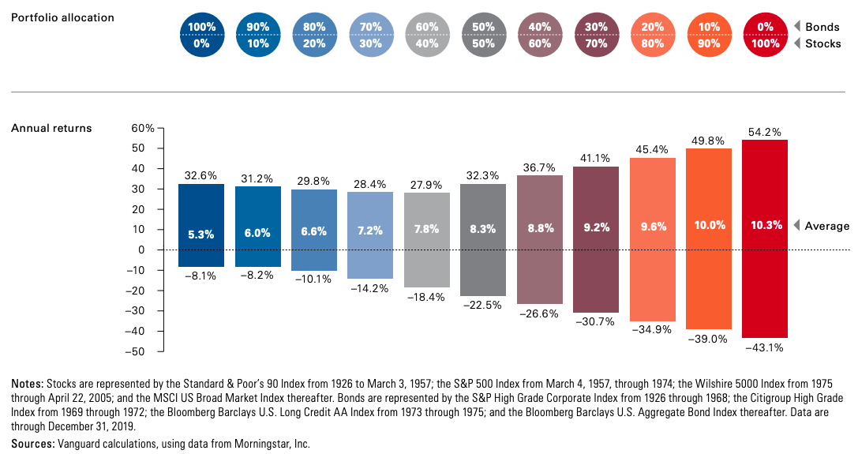
Historical Asset Allocation (1926-2019)
(Source: Vanguard.com)

Slide 28
Suggested Asset Allocation
Conservative
Aggressive
AGE RANGE | STOCK % | BOND %
20-30s | 90-100% | 0-10%
40-50s | 80-90% | 10-20%
AGE RANGE | STOCK % | BOND %
20-30s | 100% | 0%
40-50s | 90-100% | 0-10%
For a more personal approach, take the Vanguard investor questionnaire:
  https://personal.vanguard.com/us/FundsInvQuestionnaire
If you don’t want to worry about this at all, use target date funds like the TSP Lifecycle Funds

Slide 29

Prepare for the Next Market Downturn
Do not stop investing when the market is down
Best time to buy is when stocks are cheap
You need an asset allocation you can stick to when the market tanks!
  How did you feel in MAR 2020?

Slide 30
Mistakes and Changes
Mistakes
  BRS but fill the TSP too early and lose their match
  Borrow from their TSP
  Base their TSP contributions on special pays
  Utilize I Fund for international stocks exposure, ignoring emerging markets
Changes
  Upcoming “window” with more funds available
  Website changes and app development

Slide 31

Step 7 – Make an Intelligent Rent vs Buy Decision

Slide 32
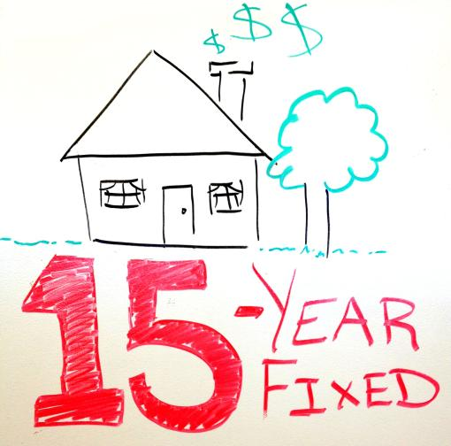
The Rule if Purchasing a House

Slide 33


Step 8 – Save for Future College Expenses
529 Plan
GI Bill Transfer
https://www.savingforcollege.com/

Slide 34
Do You Need a Financial Planner?
DO IT YOURSELF | USE AN ADVISOR
Interested in personal finance | Not interested in personal finance
Willing to learn about personal finance | Not willing to learn about personal finance
Where Can You Get One?
https://investor.vanguard.com/advice/financial-advisor/
https://www.whitecoatinvestor.com/financial-advisors/
https://www.physicianonfire.com/recommended-financial-advisors/

Slide 35
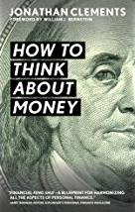
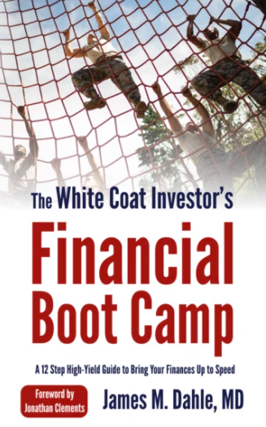


Recommended Sources for Do-It-Yourselfers

Slide 36
Recommended Sources for Do-It-Yourselfers
BogleHeads Wiki - https://www.bogleheads.org/wiki/Main_Page
Jonathan Clements Humble Dollar On-Line Money Guide - http://www.humbledollar.com/money-guide/main-menu/
MCCareer.org Finance Guide - https://mccareer.org/joel-schofers-finance-guide/
White Coat Investor Blog - https://www.whitecoatinvestor.com/

Slide 37
Special Pays After Graduation
Residency graduates
  Will have to wait until the FY22 special pays NAVADMIN is released to get specialty’s Incentive Pay (IP)
    Pay back-dated to OCT
  Until then eligible for GMO IP day after graduating
Fellowship graduates
  Already getting specialty IP
  If fellowship changes that IP, eligible after 90 days like residency graduates (must wait for FY22 NAVADMIN)
Get this handled before you detach, if possible

Slide 38

Questions?
Joel.M.Schofer.mil@mail.mil
jschofer@gmail.com
MCCareer.org
302-824-4411 (cell)

