Slide 1
FY22 Promotion Boards: What are They Looking At and How Can You Get Ready?
Joel Schofer, MD, MBA, CPE
CAPT, MC, USN
Deputy Chief, Medical Corps
Recovering Specialty Leader
Recovering Detailer

Slide 2
What are They Looking At?
Your Official Military Personnel File (OMPF)
  Last 5 years of FITREPs
  Entire record available for review
Your Officer Summary Record (OSR)
Your Performance Summary Record (PSR)
Letters to the board
DO NOT look at:
  Officer Data Card (ODC)
  Official photograph
  But you still need them both

Slide 3

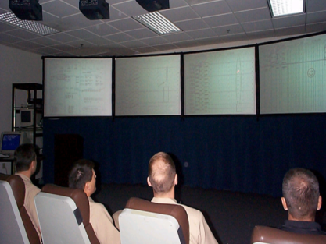
INSERT PICTURE
OF
THE TANNK
Not a real board
Pre-Board
Board Convenes
Officer reviews/updates record and submits letters to the board, as needed
Records updated by Recorders and reviewed by Board Members
The Tank….
Record briefing
Voting

Slide 4
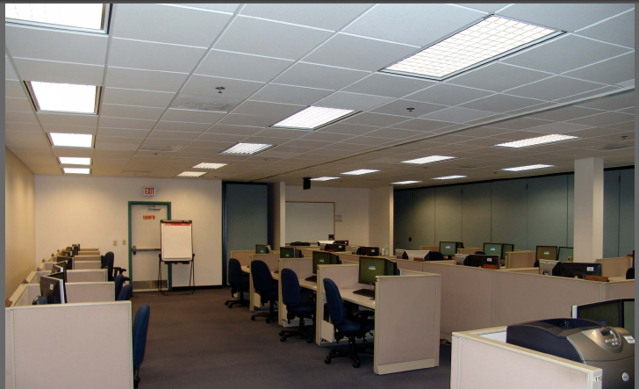
Selection Board Preparation Room

Slide 5
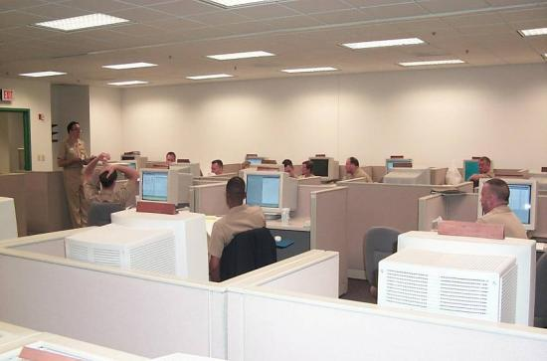
Record Review by Recorders
Week prior to board convening
  Recorders review each eligible record for completeness
  Manual reviews - done as a courtesy
    FITREPS for last 5 years
    Verify & update OSR based on OMPF and letters received
    Check that PSR accurately reflects FITREP grades
A record that is not up-to-date reflects poorly on the eligible officer!

Slide 6
Board Convenes → To "The Tank"
Voting members arrive and are sworn in
Records are randomly assigned to a primary reviewer
  Members review & grade above (AZ) and in zone (IZ) records in board prep rooms
  Do not review & grade below zone (BZ) records
  Members make notes to brief your record before the full board
  Reviewed records are electronically forwarded to “The Tank”

Slide 7
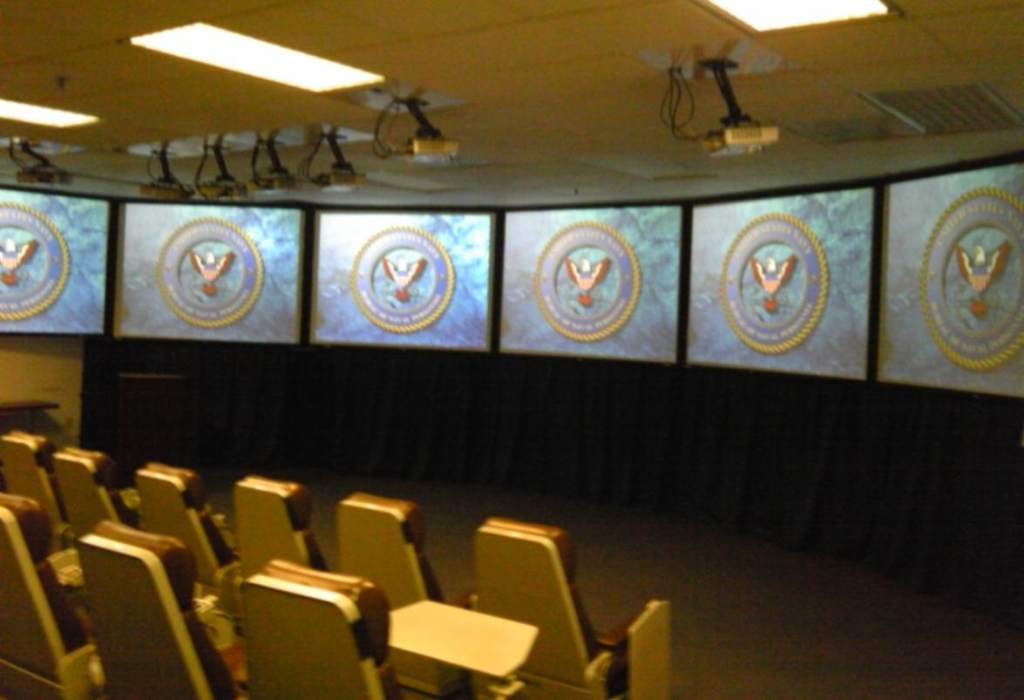
“The Tank”
Tank Room
Not a real board

Slide 8
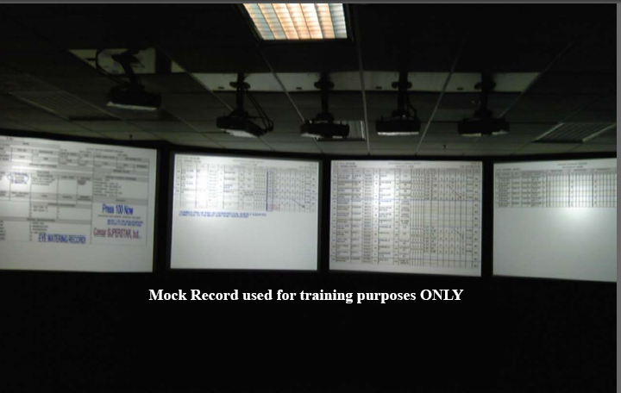
What is Displayed in The Tank?

Slide 9
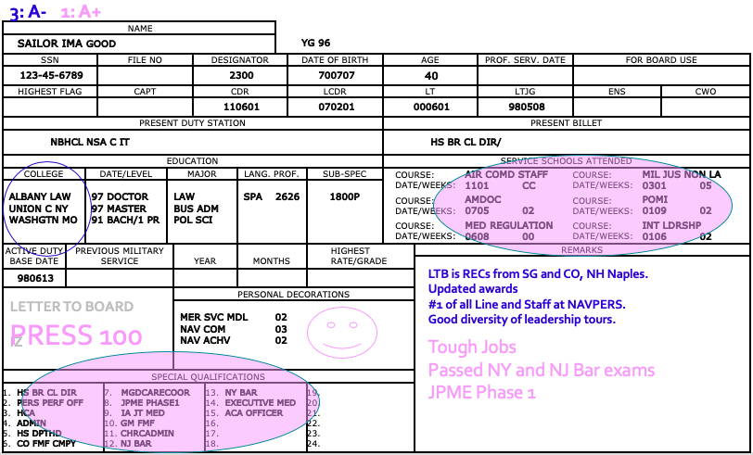
OSR Markup After Record Review

Slide 10
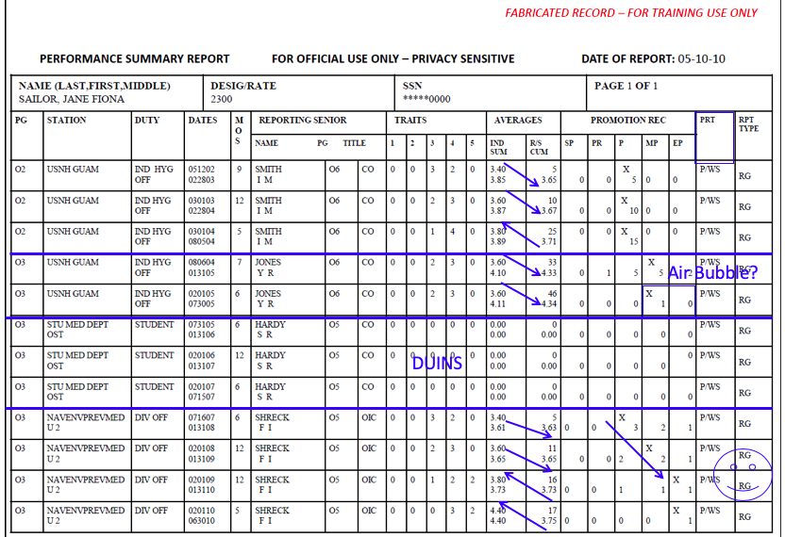
PSR Markup After Record Review

Slide 11
Let’s Get Your Record

Slide 12
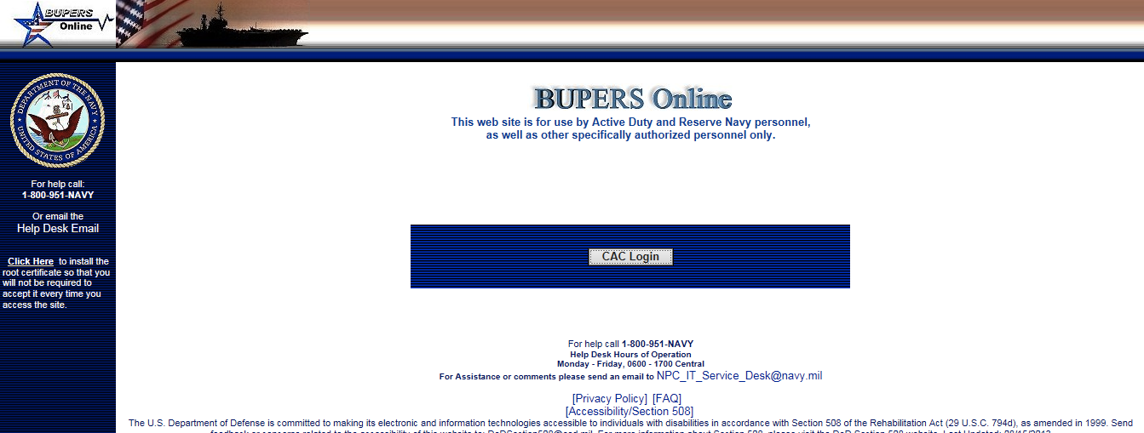
BUPERS On-Line

Slide 13
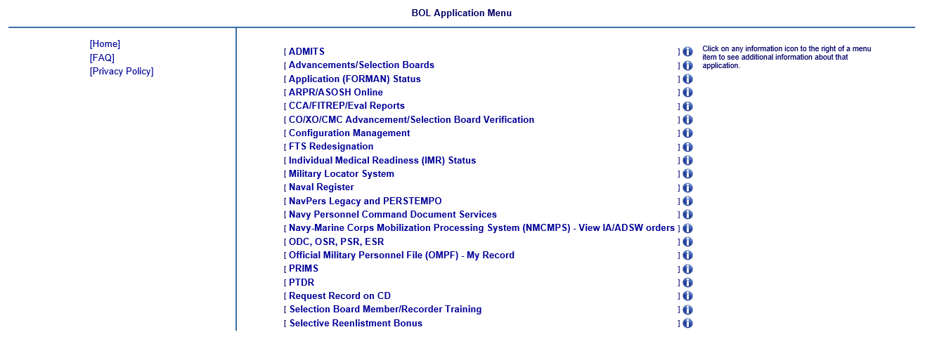
Click on OMPF Link

Slide 14
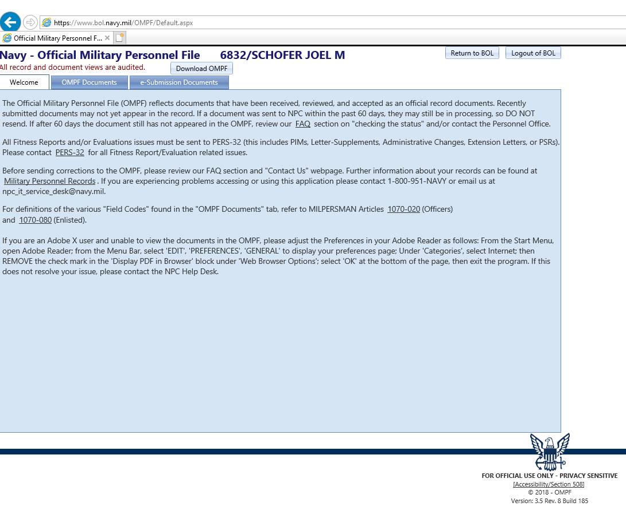
OMPF Documents

Slide 15
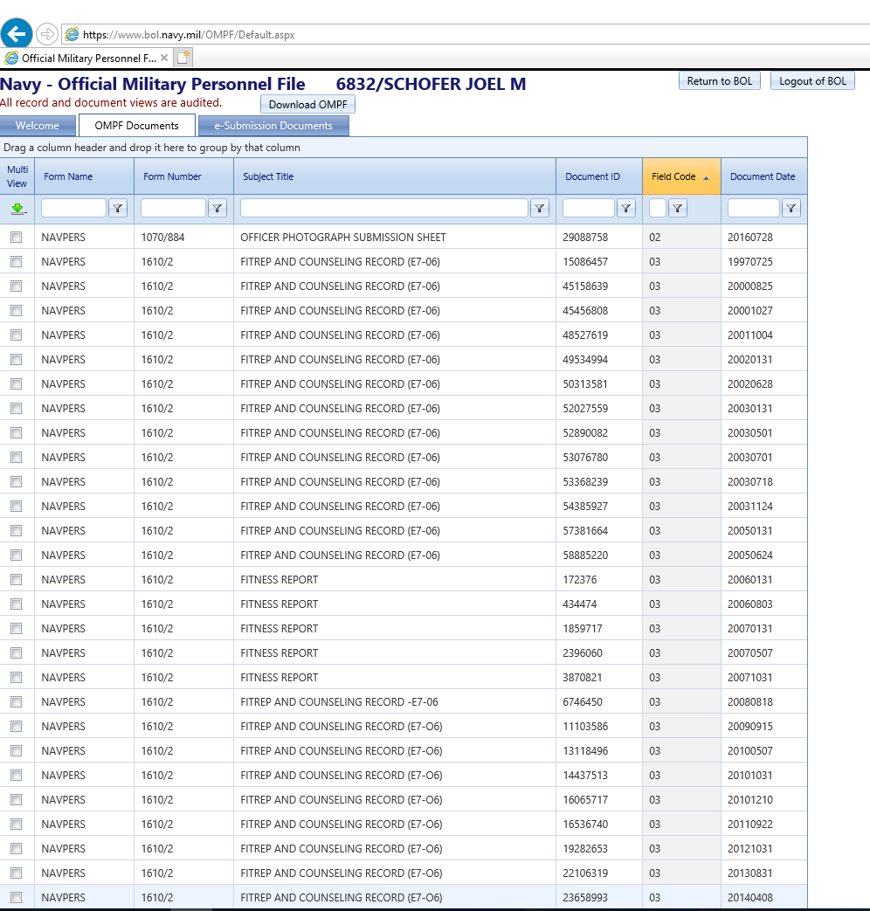
Click on the Document Name to See It

Slide 16
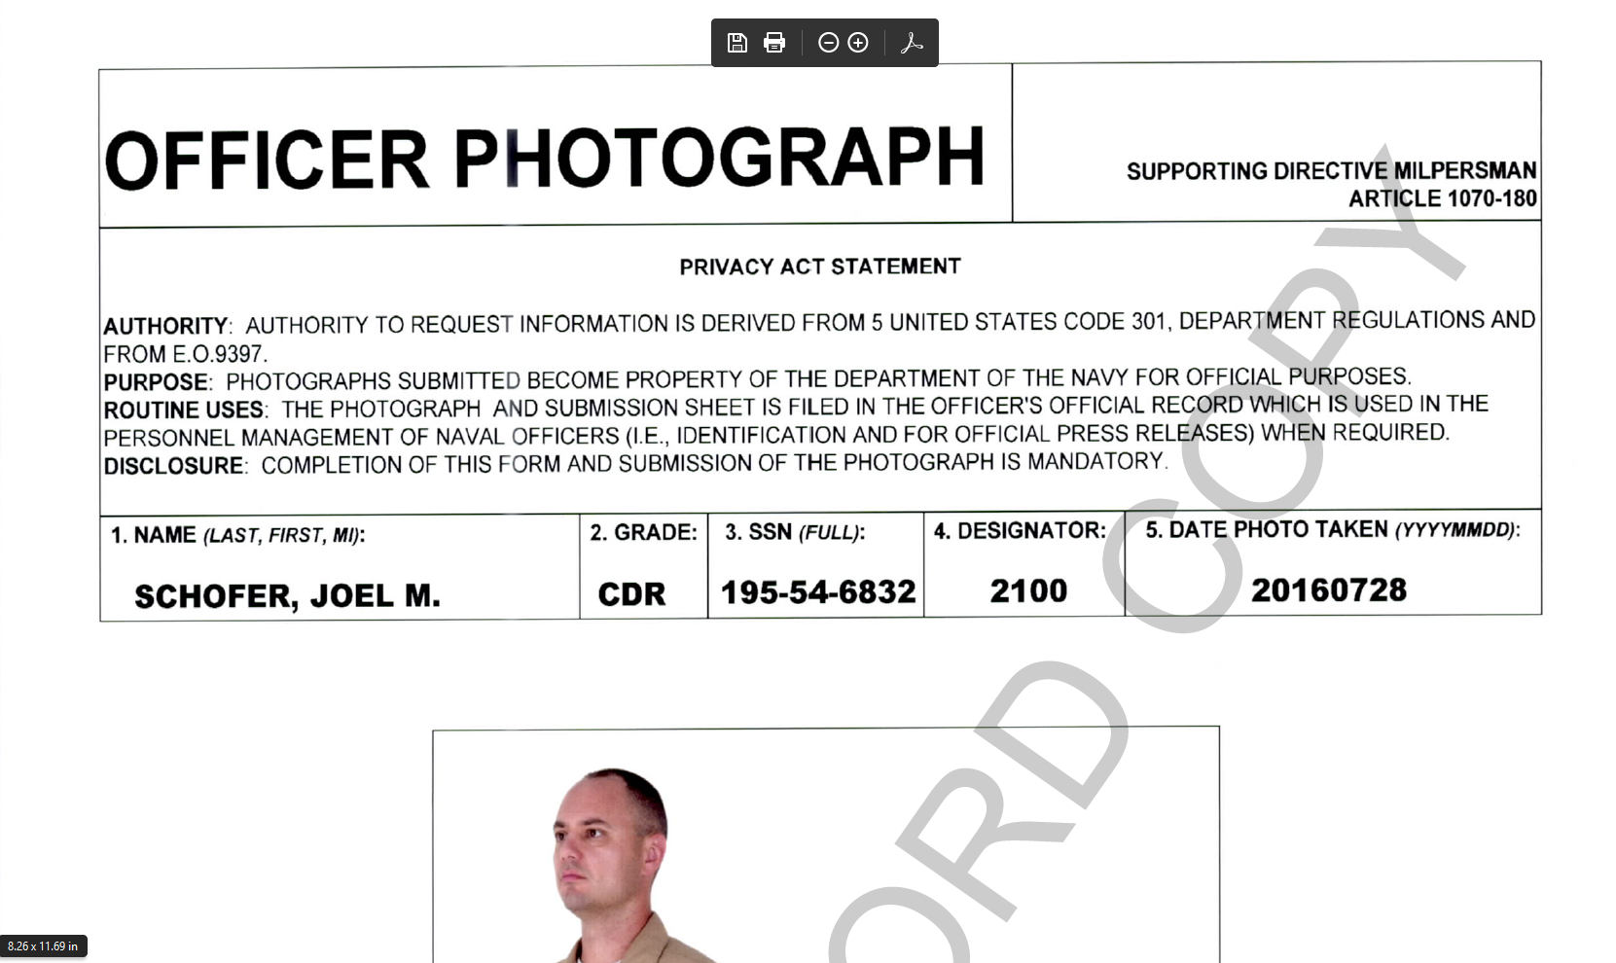
My Photo

Slide 17

If You Don’t Have a Photo in Your OMPF
Go to Medical Photography at your nearest Military Treatment Facility
Wear your khakis and full ribbon rack
Once you have the digital photo:
  Go to https://my.navy.mil and log in with your CAC card
  Go to “My Record” at the top, then find “Officer Photograph”
  The form NAVPERS 1070/884 will open and photos can be uploaded directly to the form and submitted to the OMPF
  You must use your DOD ID (not your SSN).
I did this and it took 24 hours for the photo to appear in my OMPF

Slide 18
Getting Your OSR, PSR, and ODC

Slide 19
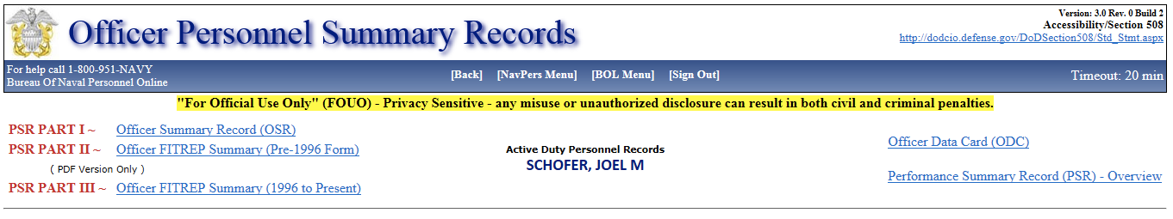
Getting Your OSR, PSR, and ODC

Slide 20
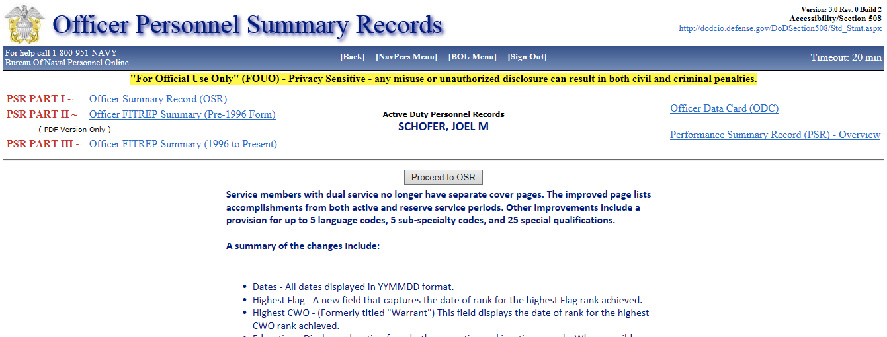
Getting Your OSR, PSR, and ODC

Slide 21
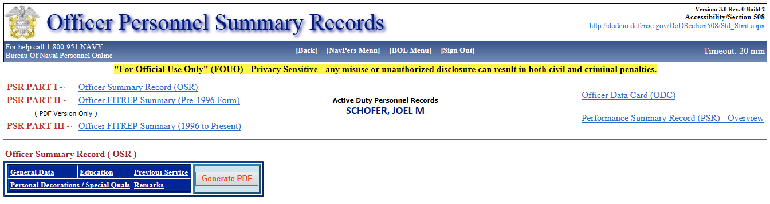
Getting Your OSR, PSR, and ODC

Slide 22
Getting Your OSR, PSR, and ODC

Slide 23
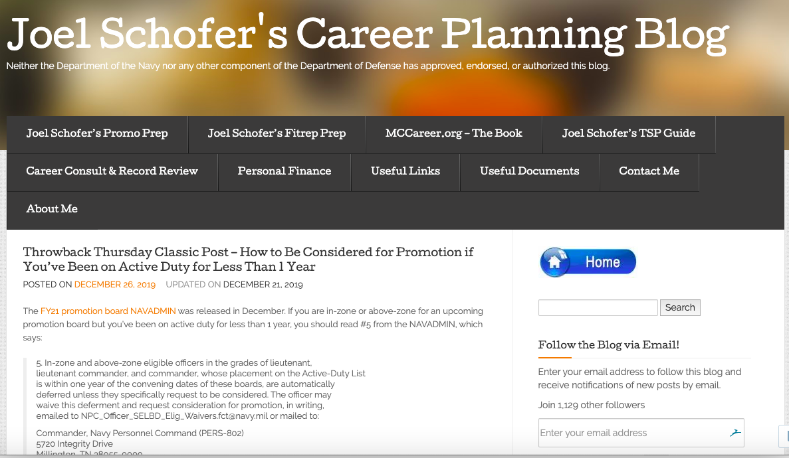
How Can You Get Ready?
MCCareer.org

Slide 24
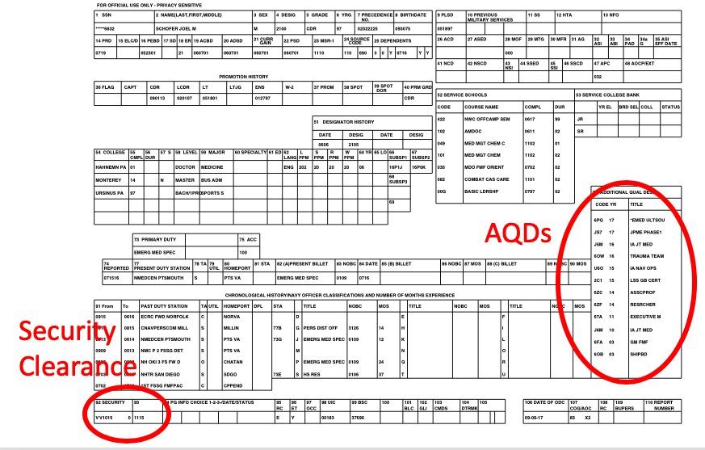
Your ODC

Slide 25
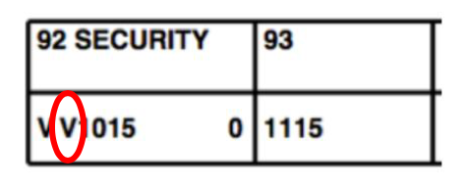
Your Security Clearance

Slide 26
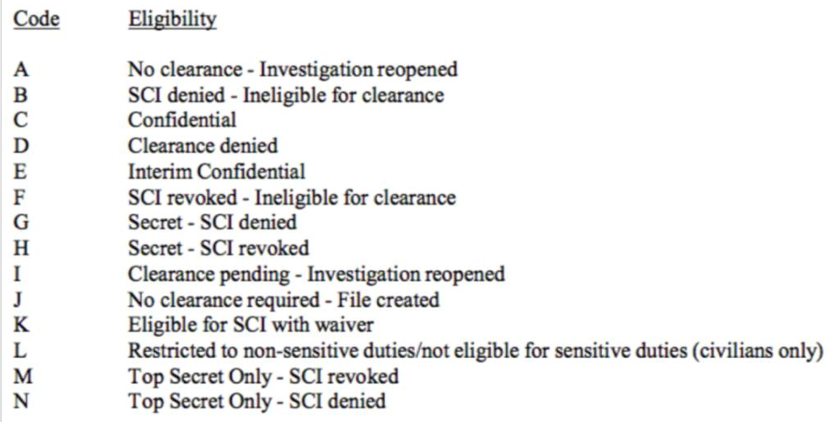
Decoding Your Letters

Slide 27
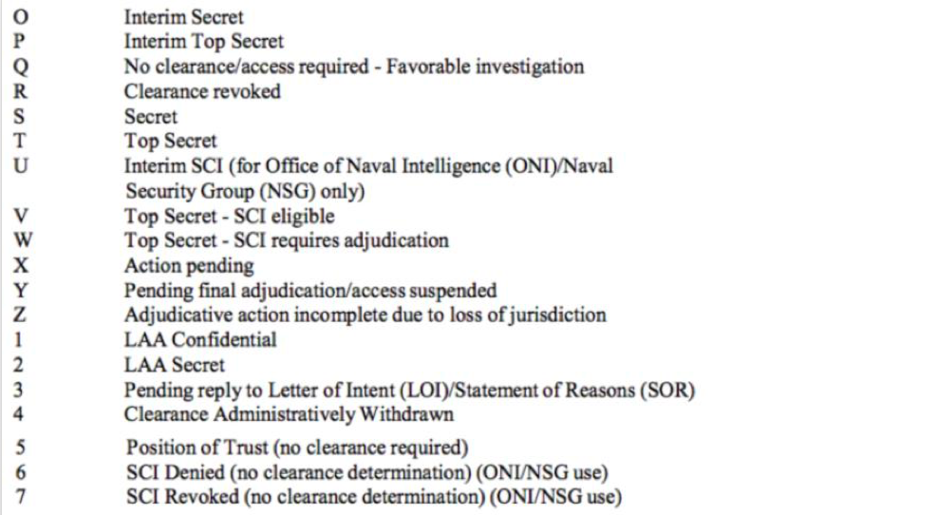
Decoding Your Letters

Slide 28
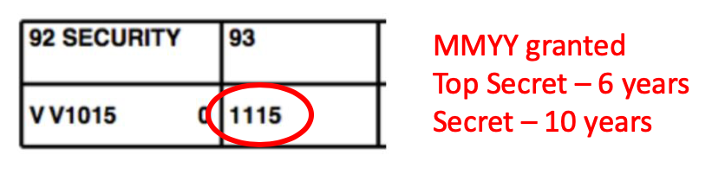
Check Your Expiration Date

Slide 29
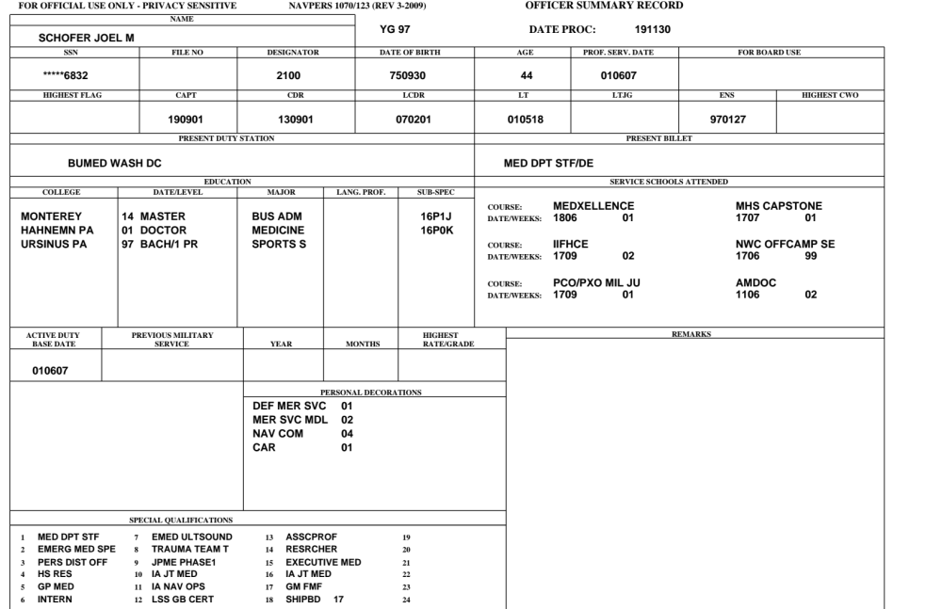
Your OSR – Subspecialty Code

Slide 30
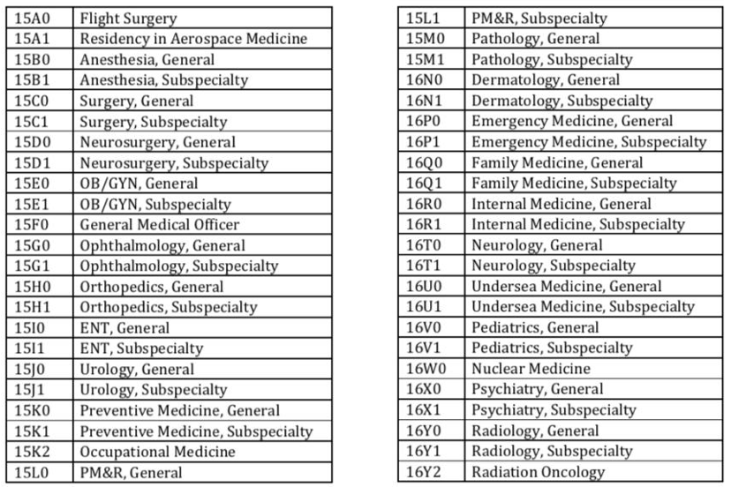
Deciphering Your Codes

Slide 31
The Rest of the OSR
Anthony Frabutt
My Navy Career Center
Joint Services Transcript OPS Center
NDAWS/BOL
Billets and AQDs

Slide 32
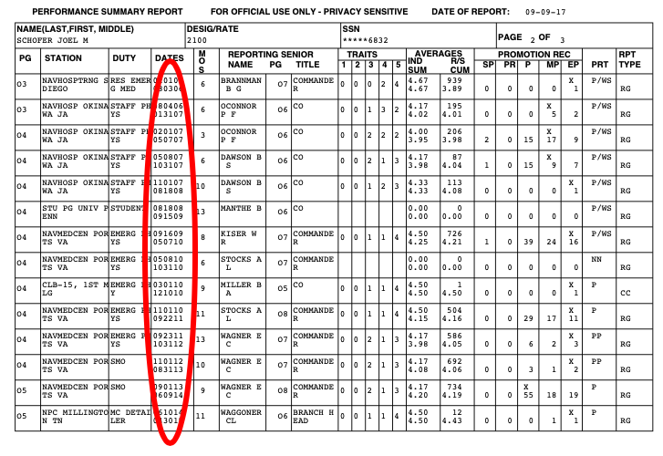
Checking Your PSR

Slide 33
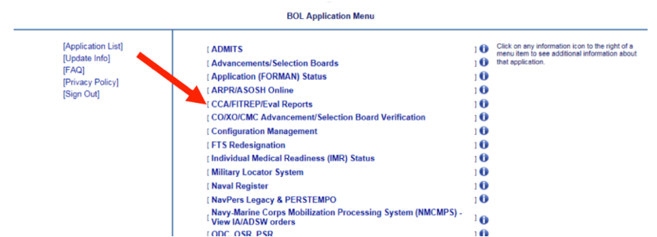
Checking FITREP Continuity

Slide 34
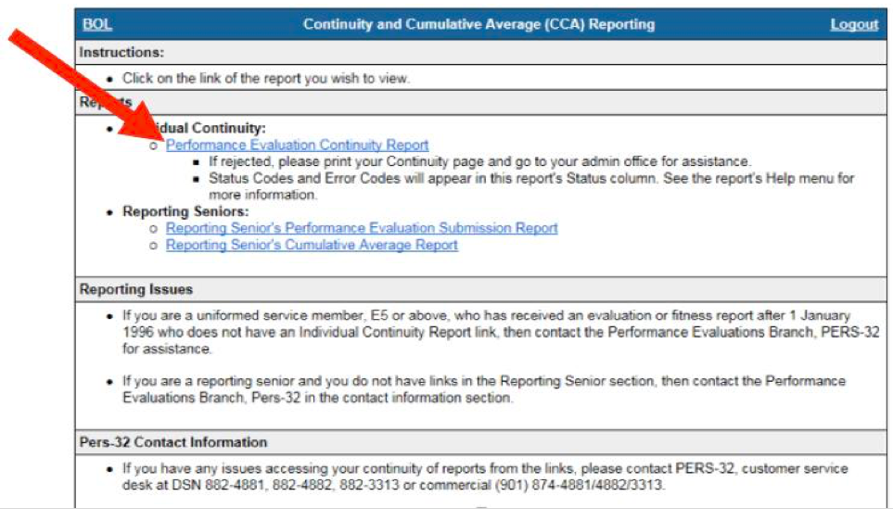
Performance Evaluation Continuity Report

Slide 35
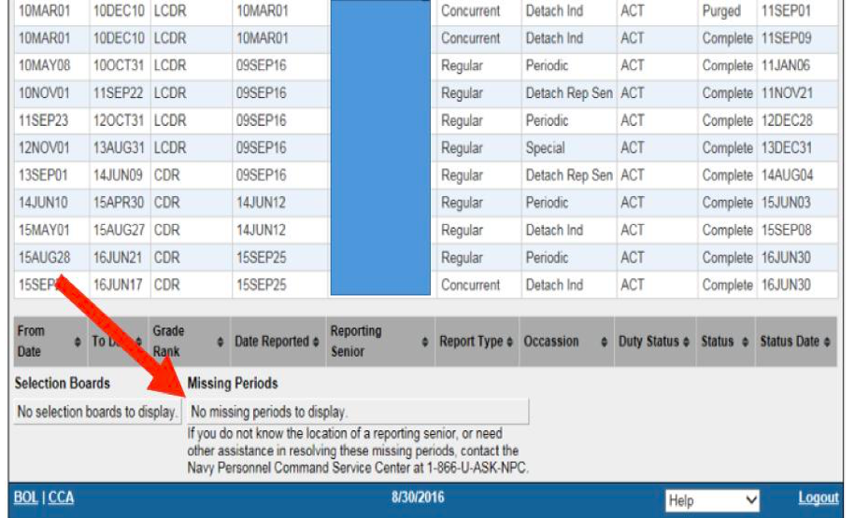
Gaps in Your FITREPs

Slide 36
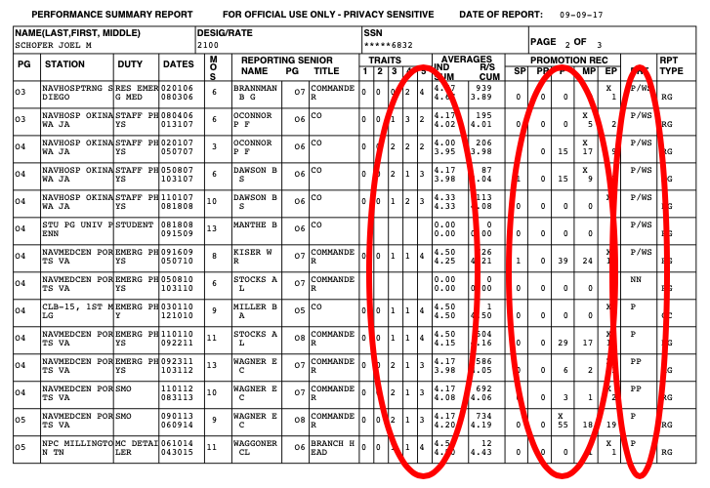
Manual Review of FITREPs

Slide 37
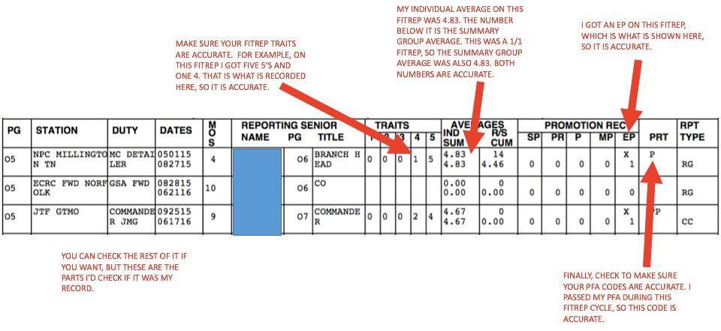

Slide 38
Letters to the Board
Usually not recommended unless new info available
Tell the board something you feel that they need to know
  You’ve tried to fix your record without success
  What do you want to do with the promotion?
Letters of recommendation
  Not from CO unless amplifying info is required
  Senior members that can provide meaningful information
  Specialty Leader is solid default choice
Watch the length and tone!
If you fail to promote, will you be kicking yourself for not sending a letter?

Slide 39
Electronic Upload of Letters to the Board
Mail and e-mail still available
Electronic submission to become the preferred method
Go to https://www.mnp.navy.mil/group/my-record
Must have all information, with attachments (if applicable), prior to beginning this process, as there is currently no “save-and-return” function
Receive an email confirmation of receipt
Questions to MyNavy Career Center (MNCC) by calling (833)-330-6622, or via DSN at 882-6622

Slide 40
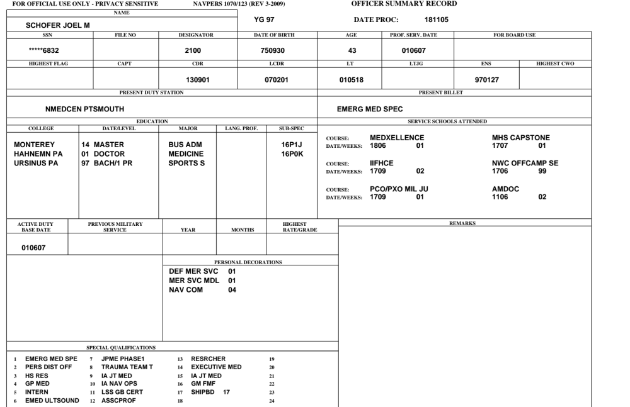
What Does the Board Want to See?
Updated your record
MD/DO degree present
Board certified
Service schools show ongoing education
Important AQDs – JPME, Exec Med, operational

Slide 41
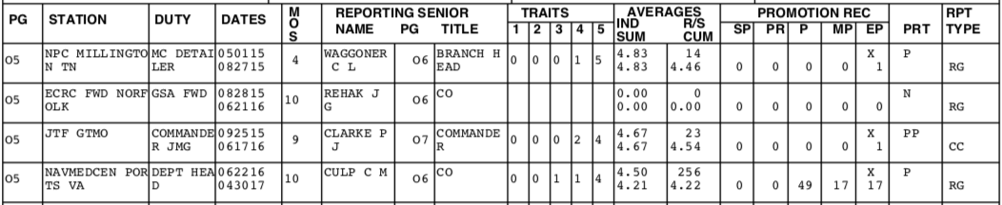
What Does the Board Want to See?
No PHA failures
Important jobs, including at least one operational job
Above the RSCA
Competitive EPs

Slide 42
How Can You Get Ready?
MCCareer.org

Slide 43
Questions?
Joel.M.Schofer.mil@mail.mil
Cell – 302-824-4411
If you want a record review, e-mail me your OSR/PSR/ODC

