Slide 1
Low-residency Graduate Education Program
Office of the Chief Learning Officer
10 July 2020

Slide 2
Program Purpose
Purpose: The Low-residency Graduate Education Program (LGEP) will allow Naval officers to pursue world-class low-residency graduate education in strategy, management and international relations in their current duty station, minimizing disruption to operational tempo and career progression. Unlike traditional graduate education, low-residency programs typically require a student to spend limited time on campus, with students working with faculty and fellow students online or by phone for the remainder of time.
Why:
Expand the number of officers pursuing graduate studies while maintaining current operational tempo and readiness.
Helps officers in warfighting communities with high operational tempos to obtain graduate degrees necessary for promotion without detailing them to operational forces for traditional full-time in-resident professional military education (PME).
Degrees earned through LGEP will fulfill the requirement for one year of in-residence, strategically-focused education for promotion to O7.
Notes:
A low-residency program (or limited residency program) is a form of education, normally at the university level, which involves some amount of distance education and brief on-campus or specific-site residencies—residencies may be one weekend or several weeks.

Slide 3
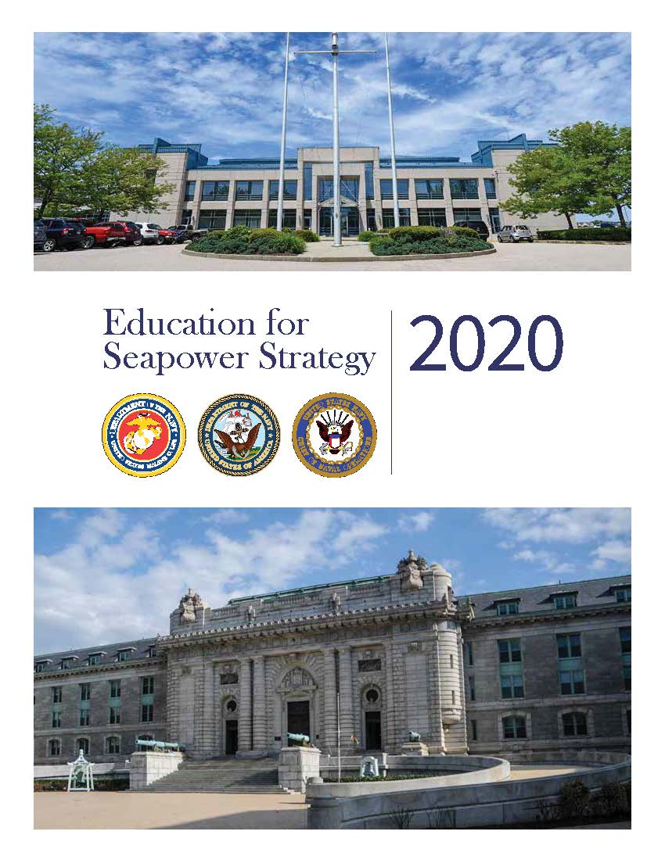
Education for Seapower Strategy
LGEP achieves two important Naval Education Strategy Goals:
Objective E: Modernize Education Program Delivery.
  Uses low-residence model to provide quality education while minimizing disruption to career paths and reducing personnel transfers.
  Expands NUS partnerships with top civilian graduate schools to provide more executive educational opportunities.
Objective G: Increase the Number of Officers Pursuing PME.
  Enables the Navy and Marine Corps to increase the number of officers pursuing high quality graduate education.
  Goal: by FY26 Navy will have at least 3.9% of officers pursuing in-residence PME

Slide 4
Program Concept:
Flexible Education for the Fleet
Select up to 100 U.S. Naval officers O-2 to O-5 for the program for Fall (September) 2020
  Program may expand in subsequent years based on the results of the pilot program.
  Program will be continuously monitored and assessed.
LGEP will partner with top graduate education programs to provide flexible low-residency options:
  Students will remain on duty station.
  Students will spend limited time on campus (time commitment will depend on particular partner university program).
Initial pilot will focus on the following fleet concentration areas, but officers outside these locations will be able to participate:
  Washington, DC
  Norfolk, VA
  Washington State
  San Diego, CA

Slide 5
Program Details
Participants would earn masters degrees:
  Master of Arts (MA) in International Studies
  Master of Business Administration (MBA)
  Executive Master of Business Administration (EMBA)
  Master of Public Policy (MPP)
  Master of Science (MS) in International Relations and Business
  MA in Global Policy
  Master of Advanced Studies in International Affairs
  Executive MA (EMA) in Applied International Studies and Public Administration
Centrally funded program covers tuition, required books, travel, and materials
Initial applications to LGEP in early July, selected candidate applications due to universities July 31, 2020
Participants would have a service obligation
  3-years, served concurrently with other obligations
  DoN policy (OPNAVINST 1520.23C, Ch.3)

Slide 6
Partner School Selection Criteria
Regionally accredited university or college in a fleet concentration area.
Nationally recognized tenured faculty with expertise in the aforementioned academic fields.
Top low-residence education programs with state of the art distributed learning capabilities.
Flexible education formats to accommodate naval officers’ needs.
Willing to accept naval officers without a competitive application process and without requiring GRE/GMAT scores.
Willing to potentially modify academic curriculum / schedule to specifically meet naval officers’ educational needs.

Slide 7
Partner Schools
Old Dominion University (ODU): MA in International Studies; 18 - 24 months
William and Mary: MBA and MPP; 18 months
American University: MS in International Relations and Business; 18 - 21 months
Johns Hopkins University School of Advanced International Studies (SAIS): MA in Global Policy; 16 months
University of California, Los Angeles (UCLA): EMBA; 22 months
University of California, San Diego (UCSD): Master of Advanced Studies in International Affairs; 18 - 24 months
University of Washington: EMA in Applied International Studies and Public Administration; 10 months or 24 months
Naval Postgraduate School (NPS) - 2021: EMBA; 24 months

Slide 8
Summary
The Fleet Graduate Education Program will:
  Increase access for officers O-2 to O-5 to quality graduate education that enhances warfighting advantage while minimizing disruption to operational assignments and career progression.
  Directly support the Naval Education Strategy objectives to modernize education program delivery and increase the number of officers pursuing in-residence education.
  Develop partnerships with top civilian universities that will strengthen the NUS.
  Support operational readiness keeping officers close to the waterfront/flight line while they pursue higher education.

Slide 9
Back-Up Slides:
Partner Graduate Program Details

Slide 10

Old Dominion University (ODU)
Master of Arts Graduate Program of International Studies-Low Residency (GPIS-LR) degree program:
24 month program, with an additional option for summer courses reducing the program to 18 months.
3-courses per semester, (full-time status) - the total credit requirement is 33 credits (11 courses).
The degree includes an option for a concentration in modeling and simulation (M&S).
NATO has accredited the program as a "Selected Program" for alliance members' education and training. No other civilian academic institutions have been awarded the "Selected Program" designation by NATO.
The program would be offered online, supplemented with dedicated on-campus instruction and mentoring.
TIME COMMITMENT: 2 visits per semester; 8 visits total

Slide 11
Old Dominion University (ODU)
GPIS-LR degree program curriculum and coursework:
The program of study will have two essential components:
  Part 1 provides substantive conceptual and theoretical knowledge in International Security.
  Part 2 is the Concentration in Strategic Leadership, offering students an in-depth study of the historic, cultural, economic, geopolitical, and technological dimension of international/global security - and their impact on U.S national security.
Beginning in fall 2020, the cohort of Naval Officers would take three program core courses: Research Methods, International Relations Theory, and American Foreign Policy, constituting Part 1.
Beginning in spring 2021, students would take courses in Collective Security, Global Security, and Cultural Studies or International History.

Slide 12

William and Mary
Master of Business Administration and Master of Public Policy-Low Residency (MBA & MPP-LR) degree programs:
18 – 24 month MBA and MPP programs.
The programs’ key features are their smaller cohort size, unique focus on the Asia-Pacific, and flexibility regarding course load and time commitment.
Degrees offer students the unique opportunity to conduct portions of their study overseas.
The MBA degree integrates classroom instruction over 7-week sessions with small learning teams, experiential learning opportunities, and one-on-one mentorship through the Executive Partners program.
The MPP degree includes data analysis, economics, political science, and law through the required core curriculum, while enabling opportunities for further specialization through elective coursework and practical learning experiences.

Slide 13
William and Mary
MBA & MPP-LR degree program curriculum and coursework:
MBA students have the option to pick six areas of specialization: Business Analytics, Consulting, Finance, Innovation and Entrepreneurship, Marketing, and Supply Chain.
MBA students are provided with opportunities to work with faculty, staff in the Graduate Career Management Center, and Executive Partner on assignments outside of the traditional classroom setting.
MPP students follow a core curriculum which includes:
  Foundations in Political Environment.
  A year long Economics sequence.
  A year long Quantitative Methods sequence.
  A year-long Law sequence that includes a specialized Law and Public Policy course designed just for MPP students.
  At least one law elective taken with faculty at William and Mary’s Law School.
MPP students are exposed to core public policy concepts through inquiry, research, and application while developing fundamental analytical and communication skills.
TIME COMMITMENT: Two weekends a month, Friday and Saturday

Slide 14

American University
Master of Science, Management (Leadership and Security Studies)-Low Residency degree program:
The program will be completed in 18-21 months (five semesters, including one summer session).
The fall and spring semester courses will be a combination of traditional 15-week courses and weekend courses that are 5-7 weeks long. The summer courses will be 6 weeks in duration.
30-credit program consisting of 18 credits of strategic business and management courses and 12 credit hours of strategic leadership and cybersecurity governance courses.
Hybrid delivery format, combining synchronous and asynchronous online course work with monthly weekend in-person residency sessions.

Slide 15
American University
MS-LR degree program curriculum and coursework:
This is the only program that will issue a Master of Science (MS).
MS students are able to obtain education that combines strategic leadership with a focus in science and technology (S&T).
The Kogod School of Business faculty engage students in the classroom build their business, communications, and critical thinking skills through published case studies, group projects, experiential learning, networking opportunities, a blended delivery format, and the “flipped classroom” instructional strategy.
Coursework includes: financial accounting, strategic decision making, marketing management, business intelligence, cybersecurity governance, negotiations strategy and tactics.
TIME COMMITMENT: One weekend in residency per month

Slide 16

Johns Hopkins University – School of Advanced International Studies (SAIS)
Master of Arts, Global Policy (MAGP)
-Low Residency (MAGP-LR) degree program:
16-month program for students seeking a focus in global affairs and policy management.
Delivered in Washington, DC on an alternating weekend schedule.
Provides advanced education under the guidance of scholars, diplomats, and policymakers.
Maximum of 20 students who have at least seven years professional experience, ensuring that participants have access to a top-tier, mid-career cohort.
Program features residency experiences where students participate in policy simulations, attend strategic studies staff rides, and formulate policy work on a bi-weekly basis in the nation’s capital.
TIME COMMITMENT: Three to four two-day residencies total

Slide 17
Johns Hopkins University – School of Advanced International Studies (SAIS)
MAGP-LR degree program curriculum and coursework:
The innovative curriculum combines theory and practical application through interactive seminars and experiential learning opportunities to develop student’s expertise in policy and international affairs.
There are three multi-day residencies in the Washington, DC area designed to challenge students to apply lessons learned from coursework and to build policymaking, negotiation, and leadership skills.
During the final module of the program, students will work on individual global policy research projects and travel internationally for one week to conduct interviews and site visits.
Coursework includes: Introduction to International Economics, International Policy, Global Trade and Policy, Strategy and the Use of Force, Contemporary Issues in American Foreign Policy, International Monetary Policy and Banking, Conflict Management and Negotiations, and Global Policy.

Slide 18

University of California, Los Angeles (UCLA)
Executive Master of Business Administration-Low Residency (EMBA-LR) degree program:
22-month curriculum that educates students how to tackle business challenges.
UCLA offers a unique option to pursue an EMBA in bi-weekly or monthly class sessions, allowing cohorts to experience different frequency/intensity of curriculums in a larger university setting.
The EMBA’s cohort ensures a small student team represented by experts in accounting/finance, sales/marketing, technology/engineering, military/leadership and health care/law.
TIME COMMITMENT: One weekend a month

Slide 19
University of California, Los Angeles (UCLA)
EMBA-LR degree program curriculum and coursework:
Leadership Foundations starts with the opening one-week residential experience and continues throughout the 22-month Executive MBA program.
Focuses on developing leadership skills within students and addresses practical decision-making challenges.
Students learn to recognize cognitive biases in themselves and in others, and gain skills to re-calibrate group dynamics in order to achieve better results.
Coursework includes: Leadership Foundations, Data and Decisions, Organizational Behavior, Financial Accounting, Economic Analysis for Managers, Marketing Strategy & Policy, Introduction to Strategic Management Research.

Slide 20

University of California, San Diego (UCSD)
Master of Advanced Studies in International Affairs, Strategic Studies-Low Residency (MASIA-LR) degree program:
UCSD offers two strategic studies degrees focused on:
  Great power competition (Chinese) economics and foreign policy.
  Science, technology, engineering, and mathematics (STEM).
Students who are enrolled full time complete the degree in a nine-month academic year.
A part-time enrollment option (2 academic years) is also available to professionals with flexible work schedules.
Combines an upper-level national security curriculum with education on current and future great power competitors, while also leveraging STEM discipline strengths.

Slide 21
University of California, San Diego (UCSD)
MASIA-LR degree program curriculum and coursework:
The Master of Advanced Studies in International Affairs core curriculum is designed to integrate the diverse subject areas of international management, politics, economics and comparative public policy.
The curriculum consists of 12 courses (48 degree units).
Two specially designed courses, offered during the fall quarter, are devoted to the politics and economics of the Pacific region and provide a solid foundation in the study of international affairs.
The capstone course, offered in the spring quarter, provides an integrative analytical exercise culminating in an written report and oral presentation.
TIME COMMITMENT: Two nights of class per week

Slide 22

University of Washington
Master of Arts in Applied International Studies, Public Administration-Low Residency (MAAIS-LR) degree program:
Students choose between a 10-month, intensive full-time program and a two-year, part-time offering.
The Master of Arts in Applied International Studies (MAAIS) consists of 58 credits, including a mix of MAAIS and Jackson School core and elective courses (35 credits), UW elective courses (10 credits); a three-quarter Professional Development Practicum; a two-quarter Applied Research Client Project (9 credits); and a Crisis Negotiation exercise (4 credits).
Program is taught and influenced by the MAAIS Civic Council, which is comprised of key corporate, nongovernmental, political, and security sector figures from companies and organizations. No other program has an advisory council like this institution.

Slide 23
University of Washington
MAAIS-LR degree program curriculum and coursework:
The MAAIS curriculum draws on the Jackson School’s strengths — world-class faculty and a commitment to interdisciplinary and comparative teaching on the world’s regions, cultures and languages.
Through coursework and other activities, students will engage with global practitioners and Civic Council members who represent leading international companies and organizations influencing global policy and decision-making.
The program curriculum provides a holistic approach to international affairs, integrating and exploring the intersections of diplomacy, development, security and business.
Program coursework including media training, advocacy, risk assessment, public speaking, policy writing and crisis decision making.
TIME COMMITMENT: One weekend (Friday-Sunday) every four to six weeks.

Slide 24

Naval Postgraduate School
Executive Master of Business Administration-Low Residency (EMBA-LR) degree program:
2- year cohort-based Master’s Degree of Business Administration.
6 one-week residential instruction periods at NPS (one week in March, June, and September of each year).
Collaborative nonresident coursework throughout the year using distributed learning.
Full-time resident NPS faculty members lead online learning and in-person during team-based instruction when on campus.
Fully accredited by AACSB, the flagship international accrediting body for schools of business and management.

Slide 25
Naval Postgraduate School
EMBA-LR degree program curriculum and coursework
(Fall 2021):
Coursework includes defense finance, acquisition, human resources, data analysis methods, and technology tools to develop analytical and resource management prowess.
Curriculum includes business innovation and leading research in each subject further preparing students to lead their Naval organizations.
Students may also obtain a graduate certificate in:
  Defense-oriented specializations related to warfighting (e.g., cyber, operational logistics).
  Decision making (e.g., data science, cost-benefit analysis).
  Leadership (e.g., innovation management, strategic leadership).
  Resource management (e.g., acquisition, financial management).

Slide 26
Low-residency Graduate Education Program
What is the Low-residency Graduate Education Program (LGEP)?
The LGEP allows Naval officers to pursue world-class low-residency graduate education in strategy, management and international relations in their current duty station, minimizing disruption to operational tempo and career progression.
Unlike traditional graduate education, low-residency programs typically require a student to spend limited time on campus per month, with students working with faculty and fellow students online or by phone for the remainder of time.
Why LPGEP? DoN Value:
Expands the number of officers pursuing graduate studies while maintaining current operational tempo and readiness.
Helps officers in warfighting communities with high operational tempos to obtain graduate degrees necessary for promotion without detailing them to traditional full-time in-resident graduate education.
Degrees earned through LGEP will fulfill the requirement for one year of in-residence, strategically-focused education for promotion to O7.
LGEP achieves two important Naval Education Strategy Goals: 1) Modernize Education Program Delivery, 2) Increase the Number of Officers Pursuing PME.
Program Concept: Flexible Low-residency Graduate Education
Students earn Master’s degrees in: International Studies, Business Administration, Public Policy, International Relations, Global Policy, International Affairs, Applied International Studies, and Public Administration.
Centrally funded program covers tuition, required books, travel, and materials.
GRE/GMAT not required for application.
Degree programs range from 10-24 months in duration.
Partner schools: Old Dominion University, William and Mary, American University, Johns Hopkins University, UCLA; UCSD, University of Washington, and NPS (2021)
POC: Dr. Kendy Vierling (kendy.k.vierling@navy.mil)
Applications
Enrollment
Begin Courses
September
Close
July 22
Open
July 15
Selection
July 31
Finalize Program
August 15
Student Selection
June-July 2020
Finalize Enrollment
August 2020
Program Begins
Aug- Sept 2020
100 naval officers grades 0-2 to 0-5 are selected by stakeholder committee
Applications due July 22, 2020
Student applications sent to schools for enrollment
Students have a service obligation of 3 years, served concurrently with other obligations
Students begin courses at one of eight partner graduate schools

