Slide 1

Debt, College, and Discretionary Spending
Joel M. Schofer, MD, MBA, CPE, FAAEM, FAAPL
Captain, Medical Corps, US Navy
Deputy Chief, Medical Corps

Slide 2
Disclosure
The views expressed in this presentation do not reflect the official policy or position of the Department of the Navy, Department of Defense, or the United States Government.

Slide 3

Managing Debt
Debt has a bad reputation, but not all debt is bad
Debt is a financial tool you can use to meet your goals

Slide 4

Millionaire Next Door
Physicians don’t accumulate wealth and have low net worth
Buy expensive houses, cars, and boats to live up to society’s expectations

Slide 5
Accumulating Debt
Productive
Non-Productive
Student loans
Mortgage
Business loans
Car loans
Boat loans
Jumbo mortgage
CREDIT CARD DEBT

Slide 6
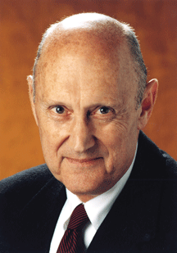
Credit Card Debt
“Keeping a balance on your credit card is about the worst financial move you can make.”

Slide 7

Credit Card Debt
If you have it, pay it off
If you can’t, ask your lender to lower your rate or transfer it to a low rate card

Slide 8
Rules of Thumb
Monthly debt payments (excluding your mortgage) should be <20% of your monthly income
Your housing costs should be <30% of your income

Slide 9
Student Loans
Average student loan in 2020 is $232K
Refinancing
Public Service Loan Forgiveness
WhiteCoatInvestor.com
  Live like a resident and pay off loans in 5 years
StudentLoanPlanner.com

Slide 10
Paying Off Debt
Paying off debt is the same as earning a guaranteed after tax rate of return equal to your interest rate
Paying off high interest rate debt is often better than investing in stocks…
Unless your employer is matching your retirement contributions

Slide 11
Paying Off Debt
Pay off higher interest rate debt first
Stretch the payment period on your low interest rate loans to free up cash for higher rate debt
If interest rate < 4%, may not make sense to pay off the debt
Consider a home equity loan to pay off high interest rate debt

Slide 12

Affording College

Slide 13
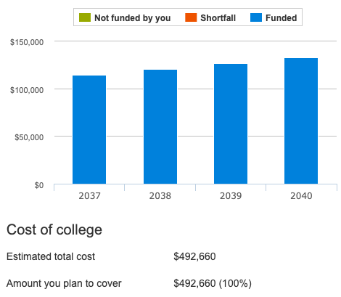
The Bad News
5% inflation
6% investment return
$1119/month for a baby born today to fully fund an average private college

Slide 14
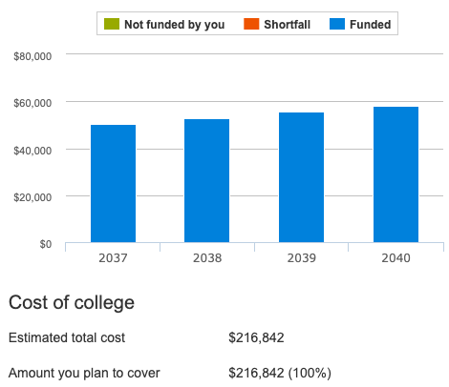
The Good News
5% inflation
6% investment return
$492/month for a baby born today to fully fund an average in-state public school

Slide 15
529 vs UGMA/UTMA
529 Plans
UGMA/UTMA
Tax-free if used for college
  Some state tax benefits
  Penalty for non-educational use
Can change beneficiaries
You control account
Your asset
Max contributions $200K+ (state dependent)
No income limitations
Invest for any purpose
Can’t change beneficiaries
Child controls account at age of majority
Child’s asset
No maximum contribution
No income limitations

Slide 16

529 Plans
Any state’s plan
Some offer tax benefits for state residents
Beware of expense ratios
Only fund after you max your retirement accounts
Savingforcollege.com

Slide 17

Discretionary Spending

Slide 18
Millionaire Next Door
Physicians don’t accumulate wealth and have low net worth
Buy expensive houses, cars, and boats to live up to society’s expectations

Slide 19
If You Can’t Help Yourself
1 spouse, 1 car, 1 house
Buy your sports/luxury car used
Rent the vacation house, don’t buy it
Flying coach isn’t that bad
Don’t buy a boat, be best friends with a boat owner
If it is important to you, save for it

Slide 20
Suggested Reading
Get a Financial Life: Personal Finance In Your Twenties and Thirties by Beth Kobliner
How to Think About Money by Clements
The Millionaire Next Door by Stanley & Danko (original version, not 2nd edition)

