Slide 1

Navy OBGYN Specialty Leader
Q and A
CDR SHANNON LAMB, MD, FACOG

Slide 2
Disclaimer
“I am a military service member. This work was prepared as part of my official duties. Title 17 U.S.C. 105 provides that `copyright protection under this title is not available for any work of the United States Government.' Title 17 U.S.C. 101 defines a U.S. Government work as work prepared by a military service member or employee of the U.S. Government as part of that person's official duties.”

Slide 3
Housekeeping
Press *6 or put your phone on mute during the call
Do NOT put your phone on hold
Un-mute when you are ready to ask a question/during Q and A at the end
Please wait until the end for questions

Slide 4
What is an OB/GYN?
A full spectrum women’s health expert
Obstetrician: Full management of pregnancy, child birth and complications
Gynecologist: Medical and SURGICAL management of the female genital tract from infancy to the elderly, Including:
  Well woman exams, contraception therapy and sterilization
  Benign disease management such as abnormal bleeding, cervical dysplasia, fibroids, pelvic pain, urinary incontinence, pelvic organ prolapse, female infertility, etc.
  Screening and treatment of GYN Cancers (endometrial, ovarian, cervical, and vulvar)
***Requires completion of a 4 year OB/GYN residency***

Slide 5
Why OB/GYN?
Surgical subspecialty with CONTINUITY of care from pregnancy to menopause
A great mix of medicine, office procedures, surgery, and deliveries
Experience the “miracle of birth” daily -at times not for the faint of heart –“Are you adrenaline-seeking”
Technology innovators –at forefront of minimally invasive surgery, DaVinci robotic system utilization, development of tissue ablation techniques, complex reconstructive cases, and infertility breakthroughs
Aging workforce, increasing demand nationwide, anticipated shortages = job security

Slide 6
Navy OB/GYN Manning
Currently >100% manned
Fellowship opportunities:
  Female pelvic medicine and reconstructive surgery (FPMRS)
  Maternal fetal medicine (MFM) –high risk OB
  GYN Oncology
  Reproductive endocrinology & infertility (REI)
Overall #s of Navy OB/GYN requirements anticipated to decrease but overall need remains!

Slide 7
OB/GYN COMMUNITY: WHO ARE WE?
Total Inventory: 134 (Currently 110% overmanned)
Number in Training: 28
Number in Executive Medicine/Fair Share: 7
Authorized Billets: 90
Urogyns: 6 (1 Retiring 2020, 2 Retiring 2021)
MFM: 8 (3 out or retiring, 3 in pipeline)
REI: 6 (2 projected to retire 2020/2021)
GYN ONC: 6 (2 projected to retire)
Fellows: 4 in pipeline, 1 MFM start 2020, 1 REI start 2021
64% female

Slide 8
WHO ARE WE?
64% Female
14 CAPT (10%)
30 CDR (22%)
48 LCDR (35%)
42 LT (31%)
Average to above average promotion rate compared to other specialties

Slide 9
OB/GYN SELECTION RATES FY 20
 | #IZ | #SEL IZ | %SEL IZ (AVE) | #AZ | #SEL AZ | %SEL AZ | #BZ | #SEL BZ | %SEL BZ
LCDR | 7 | 7 | 100% (90.51%) | 1 | 1 | 100% (60%) | 11 | 3 | 27.27% (3.71%)
CDR | 8 | 5 | 62.5% (52.8%) | 4 | 1 | 25% (27.7%) | 4 | 0 | 0 (1.3%)
CAPT | 3 | 2 | 66.67% (51%) | 8 | 2 | 25% (17.91%) | 12 | 0 | 0 (3%)

Slide 10
WHERE ARE WE (2020)?
OCONUS
CONUS: Billeted
Yokosuka: 4
Okinawa: 7
Rota: 2
Sigonella: 2
Naples: 2
GTMO: 1
Iwakuni: 2
Guam: 4
San Diego: 8
Portsmouth: 17
Walter Reed: 4
Fort Belvoir: 3
Camp Lejeune: 11
Jacksonville: 4
Pensacola: 1
Lemoore: 3
Bremerton: 4
Camp Pendleton: 5
Oak Harbor: 1
29 Palms: 3

Slide 11
MEDMACRE
What is it? Navy manning planning Tool
Proposed Phase 2 reductions (Reduce OB/GYN to 51, from FY 19 to FY 26):
  Changed due to POM20
However, may be completely different now…new projection 64-75(?) for OB/GYN (down from 89)

Slide 12
What is POM 20 (Program Objective Memorandum 2020)?
Decisions made by the Department of Defense to re-allocate billets from medical billets to wartime/operational billets.
Planned reductions starting in FY 2020
Goal is to increase lethality of forces
Billets re-allocated to platforms (not MTFs)
Unrelated to MEDMACRE
Initial projection reduced OB/GYN to 48 billets
June 2019: Congress mandated 703 research into impact on military and dependents to include local capacity to absorb network (slow your roll)
Now: Uncertain what final outcome will be

Slide 13
GME IMPACT
Historically 10-11 PGY 1 selected per year and 2 Fellowships
3 Residents per year group required per GME to maintain residency
Historically 25 applicants (varies 23-30)
Currently no plans for closing OB/GYN residency programs
BUMED Note 1524 July 2019:
  Allowed for 7 OB/GYN PGY 1, and 6 PGY2
  PGY1: 1 WRNMMC, 3 NMCP, 3 NMCSD
  PGY2: 3 NCMP, 3 NMCSD with 3 incumbents allowed
  Fellowships: zero
2020
  Not released yet

Slide 14
Navy OB/GYN Residency Programs
Military residencies will be filled first. Civilian deferments are dependent upon number needed to train but are RARE for OB/GYN. Locations available:
  Naval Medical Center Portsmouth (VA);
    Program Director Lt Col Trimble Spitzer
  National Capitol Consortium (DC)/Walter Reed National Military Medical Center
    Program Director: LTC Rhiana Saunders
  Naval Medical Center San Diego (CA)
    Program Director: CDR Kevin Byrd
Matching in OB/GYN will likely become even more competitive!
Active Duty Tour (ADT) Rotations highly encouraged!
COVID pandemic will affect students and programs alike in ability to gage interest and evaluate students

Slide 15
WHAT DOES THIS MEAN TO YOU?
Continued opportunities for progression, leadership roles and promotion
Increased competition for GME: but that is expected for all specialties given overall reduction in billets
No change in overseas billets but reduction in CONUS billets will mean no ‘homesteading’ and likely a CONUS/OCONUS op tempo
Currently uncertain what final billet distribution will be; possibility of ‘double-stuffing’ if over-manned

Slide 16
Naval Medical Center Portsmouth (NMCP)
16
Program Director
Lt Col Trimble Spitzer, MD, MC, USAF
Associated Program Directors Maj Karen Davis, MD, MC, USAF CDR Aaron Poole, MD, USN, MC

Slide 17
Program Director - NMCP
17
To schedule a rotation contact the Program Coordinator:
  Ms. Crystal Brooks
    crystal.a.brooks4.civ@mail.mil
■ 757-953-7183
Rotation Location Availability
  Residents and Interns remain at NMCP throughout their time in the program.
  There is limited availability for students to rotate at Langley AFB while at NMCP as well. Langley is a GYN rotation site for NMCP residents who find the experience worthwhile and staff very supportive.

Slide 18
Program Director - NMCP
What can NMCP offer you?
Unparalleled clinical volume: 1.02 million sq ft facility, serving >45K Tricare beneficiaries; Largest military referral medical center in the Navy
Direct teaching from experienced faculty: 25 physicians and 19 midwives/APNs, incl. in-house GynOnc, UroGyn, REI, & MFM
National exam preparation: ABOG board pass rates exceed national average
Surgical volume: NMCP has 17 ORs in addition to 3 ORs dedicated to obstetrics on L&D; residents benefit from additional outside GYN operative experience at OBICI and Langley hospitals
Research: “A Culture of Inquiry”: OBGYN Residents take part in a structured research curriculum with >20 active ongoing departmental research projects
Our trainees graduate from the program ready to accept military orders around the world. Our graduates are top notch Military Medical Corp Officers offering their specialized skills in the field of Women's Health services to ensure that Women's Health remain a top priority for the DoD medical readiness for a fit military force.
These military officers are compassionate advocates for Women's Health, and understand the needs of the female population serving in today's military.

Slide 19
Contact Info NMCP
Naval Medical Center Portsmouth (NMCP)
Program Director
  Lt Col Trimble Spitzer
  Trimble.l.spitzer.mil@mail.mil
Associate Program Director- Residents
  CDR Aaron Poole
  Aaron.t.poole.mil@mail.mil
Associate Program Director- Interns
  Maj Karen Davis
  karen.m.davis104.mil@mail.mil

Slide 20
National Capital Consortium (NCC)
Program Director
LTC Rhiana Saunders
Associated Program Director(s)
Dr. Amanda Owens, Dr. Thaddeus Mamienski

Slide 21
NCC
21
To schedule a rotation or interview contact LT Kristen Elmezzi:
  Email: kristen.l.elmezzi.mil@mail.mil
Rotation Location Availability
  Primary Site: Walter Reed National Military Medical Center
  Secondary sites
    Fort Belvior Community Hospital (FBCH)
      OB rotation PGY4/2
      GYN Surgery rotation PGY3
    Virginia Hospital Center
      OB rotation PGY2
    Memorial Sloan Kettering (New York)
      GYN ONC rotation PGY3
    Johns Hopkins Bayview Hospital or Virginia Commonwealth University
      Family Planning rotation PGY3 (opt-out option)
    Overall strong ties to civilian hospitals in the community

Slide 22
NCC
22
WRNMMC hosts a tri-service residency program:
  ACGME Accredited for 6 trainees per year
  1 Air Force, 2* Army, 1 – 2* Navy trainees per year
  Variable year to year
Our faculty represent all military services and the civilian sector, allowing for incredible breadth of mentorship and experience.
Our trainees experience progressive levels of autonomy as they advance through each post-graduate year.
  Chief residents have an opportunity to serve as junior faculty at FBCH, supervising and consulting with the Family Medicine providers.

Slide 23
NCC
Academics
Every Thursday afternoon is dedicated to carrying out didactic lectures, M&M conferences, Journal Clubs, Grand Rounds, guest speakers, and fitness or Wellness Activities.
Our curriculum includes monthly simulation training, covering topics in both obstetrics and gynecology.
Our residents also serve as preceptors for quarterly OSCE assessments.
Other Opportunities
We support resident pursuit and involvement in international service opportunities with humanitarian surgical missions
  Most recent: Teaching mission in Tanzania, surgical humanitarian mission in Guyana, and on assignments on the USNS Comfort.

Slide 24
NCC
24
Teaching and Leadership
Residents serve as teaching faculty and mentors to medical students from the Uniformed Services University of Health Sciences.
Research
Residents have opportunities to build an extensive research portfolio. Research experiences are enhanced under the mentorship of faculty and fellows in the onsite specialty fellowships: Reproductive Endocrinology Infertility (REI), Female Pelvic Medicine and Reconstructive Surgery (FPMRS), Gynecologic Oncology (GYN ONC), and Minimally Invasive Gynecologic Surgery (MIGS).
Additional research opportunities are available under the guidance of our Maternal Fetal Medicine faculty and through collaboration with the supporting personnel in the Uniformed Services University, the WRAIR Simulation Center, and the National Institute of Health.

Slide 25
Naval Medical Center San Diego (NMCSD)
25
Program Director
CDR Kevin Byrd MC USN
Associate Program Director
CDR Monica Lutgendorf MC USN

Slide 26
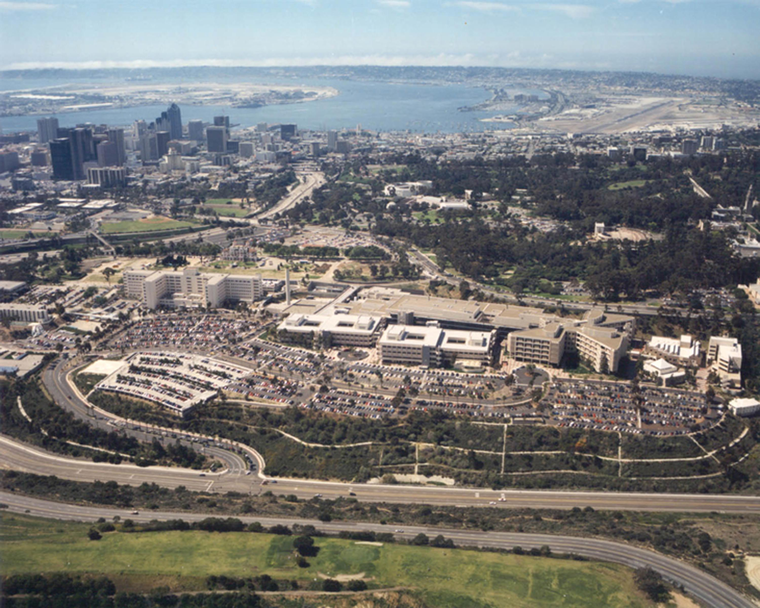
26

Slide 27
NMCSD
27
To schedule a rotation contact the Program Coordinator:
  Mr. Jeremy Westbrook
    jeremy.l.westbrook.civ@mail.mil
    619-532-5617
Rotation Location Availability
  Most rotations are at NMCSD
  Partnerships for robust experience
    Veteran’s Administration (surgical)
    Private Gynecologic Oncology PGY3 Rotation
    Scripps benign GYN PGY3 rotation
    Planned Parenthood for first and/or second trimester termination experience (may opt out)

Slide 28
NMCSD
RELAX! **You will get trained well at any Program in the Navy**
Where does NMCSD excel?
  People!
    21 physicians
      9.5 subspecialists, 11.5 comprehensive (* one is half each)
      Longevity
        Of 21 staff
          11 were my staff at graduation in 2008
          6 are alumni since that time
    12 NP/CNM
  Robust clinical partnerships allow competency in a spectrum of settings
  Focus on Clinical Competence
    Our goal is your ability and eventual board certification
  Robust Process Improvement
    REST (ROB rounding)
    ERAS
    ERAC
    Postpartum visitis (MILC)
    Contraception (PINC)
    Outpatient Cervical Ripening

Slide 29
NMCSD
Naval Medical Center San Diego (NMCSD)
Program Director
  CDR Kevin Byrd
  Kevin.a.byrd.mil@mail.mil
Residency Program Adminisrator
  Mr. Jeremy Westbrook
  Jeremy.l.westbrook.civ@mail.mil

Slide 30
Questions?
CDR Shannon Lamb
Shannon.v.lamb.mil@mail.mil
Desk: 703-681-9266 (Until 6 July 2020)

