Slide 1
Playing the Game: Managing Your Military Career
Joel M. Schofer, MD, MBA, CPE, FAAEM, FAAPL
CAPT, MC, USN
Deputy Chief, Medical Corps

Slide 2
Topics to Cover
Players in the game
The game
  Promotion boards
  Career progression
  Fitreps
  Geography

Slide 3
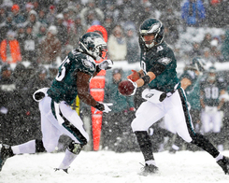
Players in the Game

Slide 4
Players in the Game
You
Your Specialty Leader (SL)
Your Detailer
Senior physicians in your specialty

Slide 5
Specialty Leader
Liaison between BUMED and the specialty as a whole
Coordinate deployments
  Return to platform based deployments lessens control a little
Coordinate PCS orders with Detailer

Slide 6
Detailer
Navy Personnel Command
Officer’s advocate
  Speaks with SL
  Approves extension requests
  Promotion board preparation
  Nominates members for promotion boards
Writes your PCS orders
  Desires of the individual vs needs of the Navy
No influence on command-level leadership positions

Slide 7
You – The MVP of the Game
YOU must actively manage your career to get what you want
Talk with SL and Detailer 9-18 months ahead of projected rotation date (PRD)
  Short and long-term goals
  Career vs resignation/retirement
  Family situation
  Medical situation
Be honest – it’s a small Navy

Slide 8

Your Specialty Specific List
Specialty Leader
Detailer
Senior operational leaders
Residency Directors
XOs
COs
Admirals

Slide 9

Questions About the Players?

Slide 10
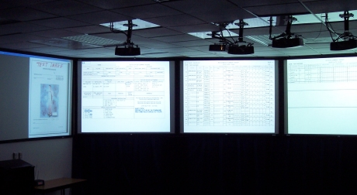
The Arena - “The Tank”

Slide 11

Promotion Board Membership
Voting Members - 2/3rds w/ exp
Senior Member
Specialty Officers | Minority Female | East Coast West Coast OCONUS
Line Officer
Recorders (CONUS only)
Specialty Officers
Head
Recorder
Assistant
Recorder(s)

Slide 12
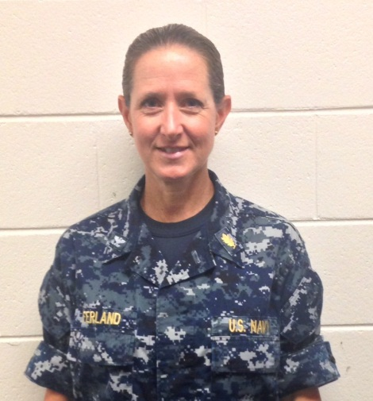
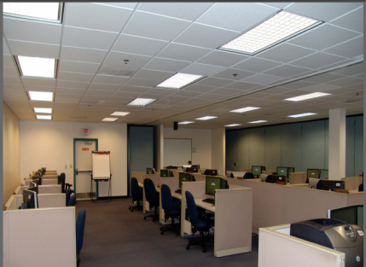
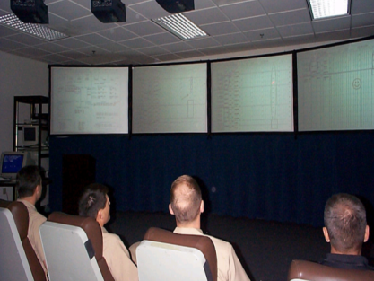
Promotion Board Flow
INSERT PICTURE
OF
THE TANNK
Not a real board
Pre-Board
Board Convenes
Officer reviews record/submits needed documentation
Records reviewed
The Tank….
Record briefing
voting

Slide 13
Pre-Board
Your Record Your Responsibility
Your Record = You
Available on BOL:OMPF Link
Check and update annually
PDF version of OSR and PSR are what the board sees
ODC primarily for viewing AQDs and checking security clearance

Slide 14
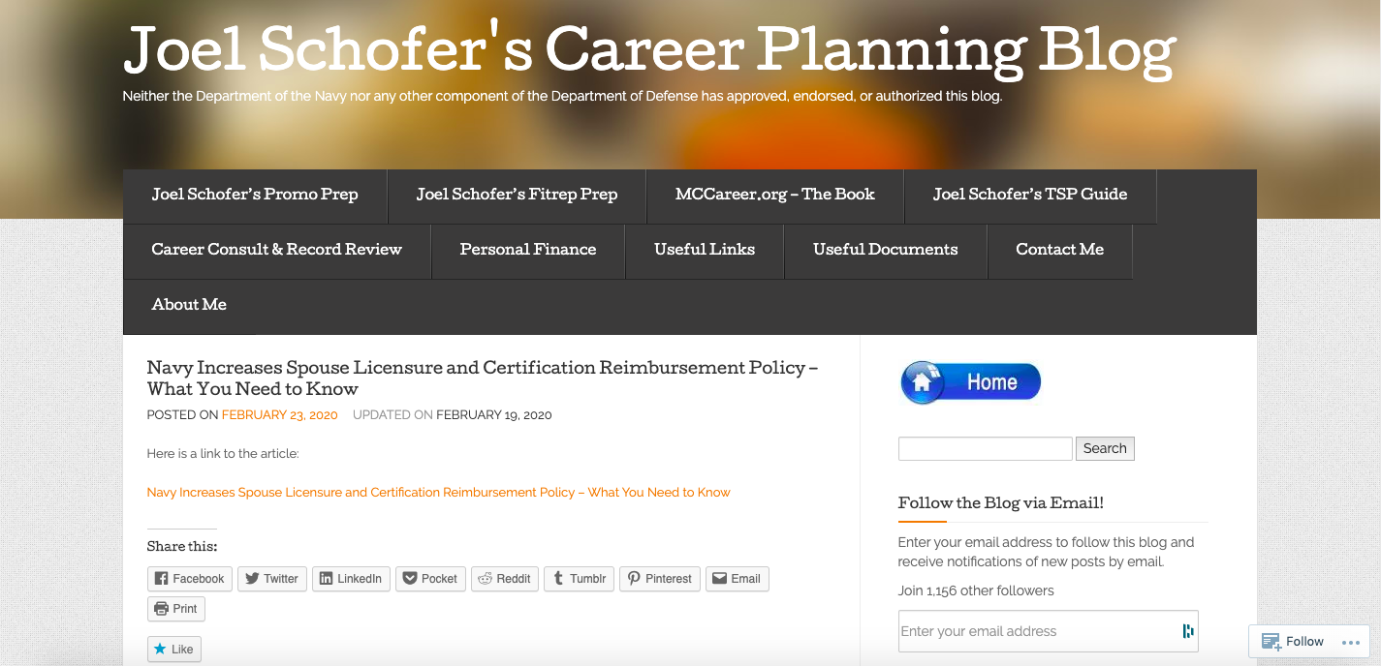
MCCareer.org

Slide 15
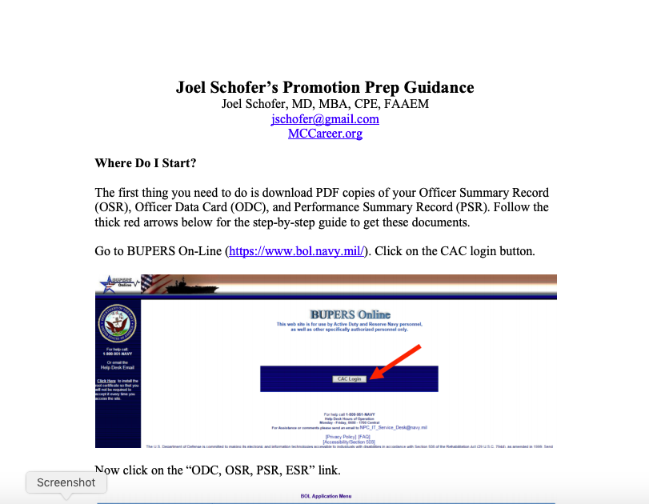

Slide 16
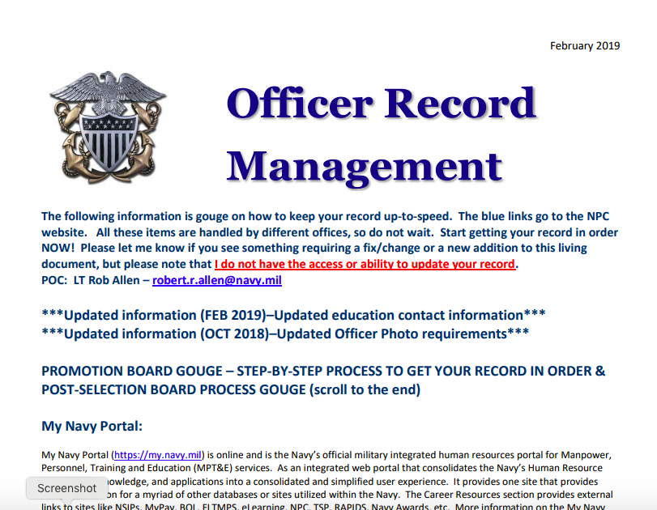

Slide 17
Letters to the Board
Usually not recommended for below-zone or in-zone unless new info available
Tell the board something you feel that they need to know
Letters of recommendation
  Not from CO unless amplifying info is required
  Senior members that can provide meaningful information
  Specialty Leader is solid default choice
Watch the length and tone!
If you fail to promote, will you be kicking yourself for not sending a letter?

Slide 18

Selection Board Preparation Room

Slide 19
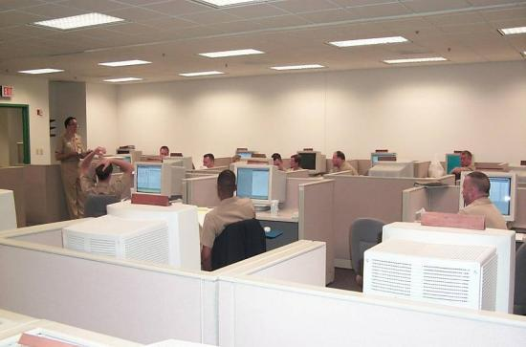
Record Review
Week prior to board convening
  Recorders review each eligible record for completeness
  Manual reviews - Done as a courtesy
    FITREPS for last 5 years
    Verify awards/education
    Check that OSR/PSR accurately reflects FITREP grades & awards
A record that is not up-to-date reflects poorly on the eligible officer!

Slide 20
Board Convenes → To the Tank
Voting members arrive and are sworn in
Records are randomly assigned to a primary reviewer
  Members review & grade records in boardrooms
  Members make notes to brief your record before the full board
  Reviewed records are electronically forwarded to the voting area (“The Tank”)

Slide 21
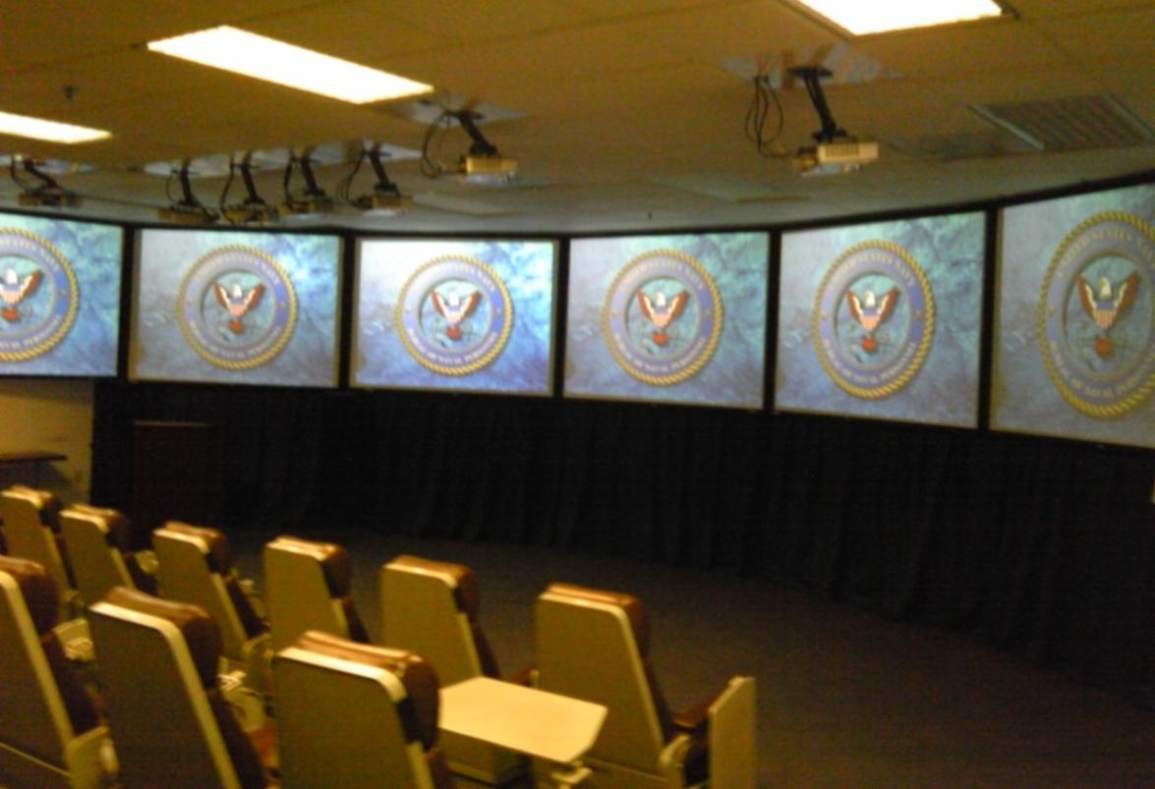
Tank Room
Not a real board

Slide 22
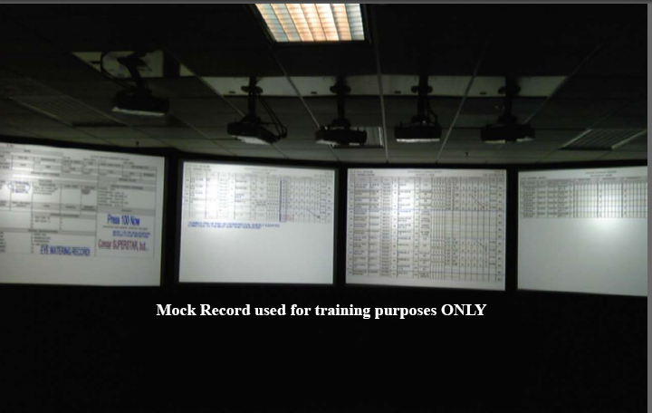
What’s on the Screens
Not a real board

Slide 23


In the Tank
Members brief & vote records until all AZ/IZ records reviewed
  Head recorder calls your name and number
  Primary reviewer briefs your record
  Members listen and vote when they’ve heard enough
  Members with personal knowledge of the you may voice positive comments
  No negative information is ever permitted, unless it is documented in the record!
  Usually 1-2 minutes per record
Not a real board

Slide 24
OSR Markup After Record Review
3: A-
1: A+
NAME
YG 96
SAILOR IMA GOOD
SSN
FILE NO
DESIGNATOR
DATE OF BIRTH
AGE
PROF. SERV. DATE
FOR BOARD USE
123-45-6789
2300
700707
40
HIGHEST FLAG
CAPT
CDR
LCDR
LT
LTJG
ENS
CWO
110601
070201
000601
980508
PRESENT DUTY STATION
PRESENT BILLET
NBHCL NSA C IT
HS BR CL DIR/
EDUCATION
SERVICE SCHOOLS ATTENDED
COLLEGE
DATE/LEVEL
MAJOR
LANG. PROF.
SUB-SPEC
COURSE:
DATE/WEEKS:
AIR COMD STAFF
1101 CC
COURSE:
DATE/WEEKS:
MIL JUS NON LA
0301 05
ALBANY LAW
UNION C NY
WASHGTN MO
97 DOCTOR
97 MASTER
91 BACH/1 PR
LAW
BUS ADM
POL SCI
SPA 2626
1800P
COURSE:
DATE/WEEKS:
AMDOC
0705 02
COURSE:
DATE/WEEKS:
POMI
0109 02
COURSE:
DATE/WEEKS:
MED REGULATION
0608 00
COURSE:
DATE/WEEKS:
INT LDRSHP
0106 02
ACTIVE DUTY
BASE DATE
PREVIOUS MILITARY
SERVICE
YEAR
MONTHS
HIGHEST
RATE/GRADE
REMARKS
980613
LTB is RECs from SG and CO, NH Naples.
Updated awards
#1 of all Line and Staff at NAVPERS.
Good diversity of leadership tours.
LETTER TO BOARD
IZ
PERSONAL DECORATIONS
MER SVC MDL
NAV COM
NAV ACHV
02
03
02
PRESS 100
Tough Jobs
Passed NY and NJ Bar exams
JPME Phase 1
SPECIAL QUALIFICATIONS
1. HS BR CL DIR
2. PERS PERF OFF
3. HCA
4. ADMIN
5. HS DPTHD
6. CO FMF CMPY
7. MGDCARECOOR
8. JPME PHASE1
9. IA JT MED
10. GM FMF
11. CHRCADMIN
12. NJ BAR
13. NY BAR
14. EXECUTIVE MED
15. ACA OFFICER
16.
17.
18.
19.
20.
21.
22.
23.
24.
Notes:
Recorder: This slide highlights specific areas on the cover page of the OSR/PSR. During your review of a record, you can highlight important aspects of an officer’s career by marking the record as has been done on this sample record. The cover page will be projected on screen one in the tank, leaving the remaining screens for fitness report summaries.
On this cover page, you can see examples of first and second, and third reviewer comments as indicated by the different colors associated with their reviews. The marks in the right top margin of the brief sheet identify the reviewer number and their grade. Also displayed in the block above the special qualifications section are various stamps used to highlight an officers record. These stamps are placed on the cover page by NPC, not by the recorders.

Slide 25
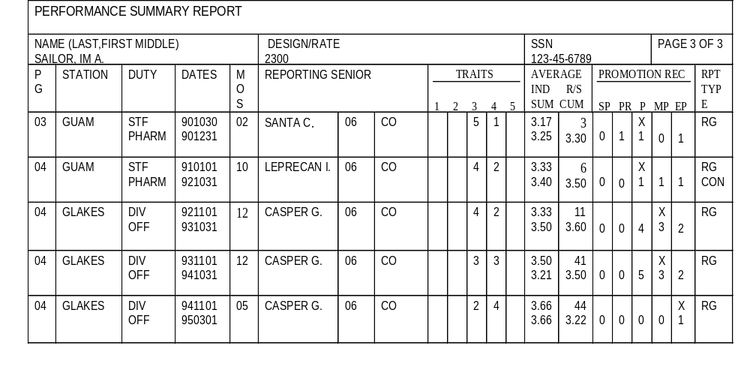
Performance Summary Report
REPORTING SENIOR
CUMULATIVE AVERAGE
All officers of that grade (regardless of designator) that the reporting senior has rated.
INDIVIDUAL TRAIT
AVERAGE
SUMMARY GROUP
TRAIT AVERAGE

Slide 26
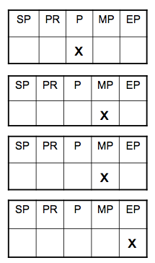
“Breaking Out to the Right”

Slide 27
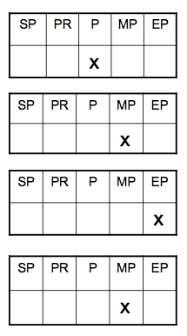
“Moving to the Left”

Slide 28
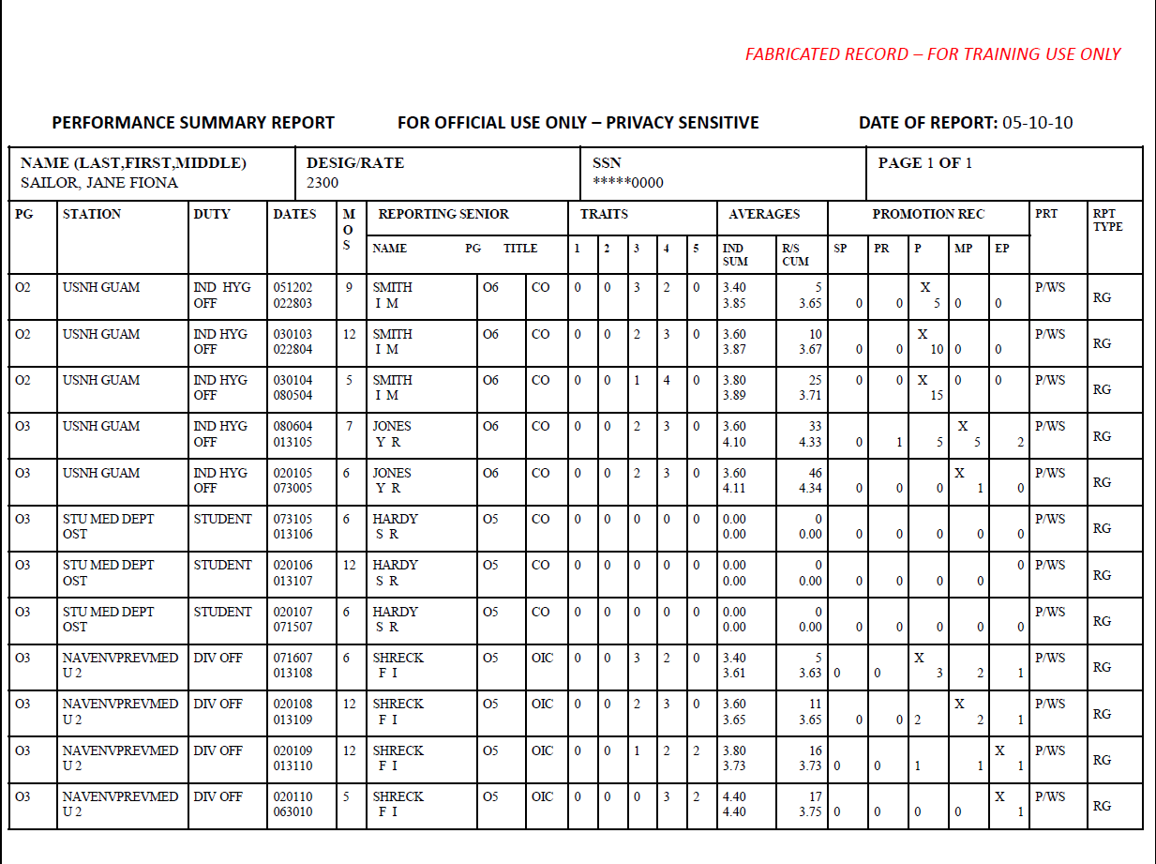
Air Bubble?
DUINS

Slide 29
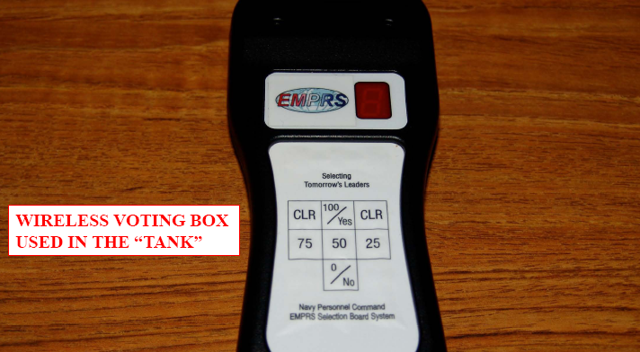
Voting Apparatus

Slide 30
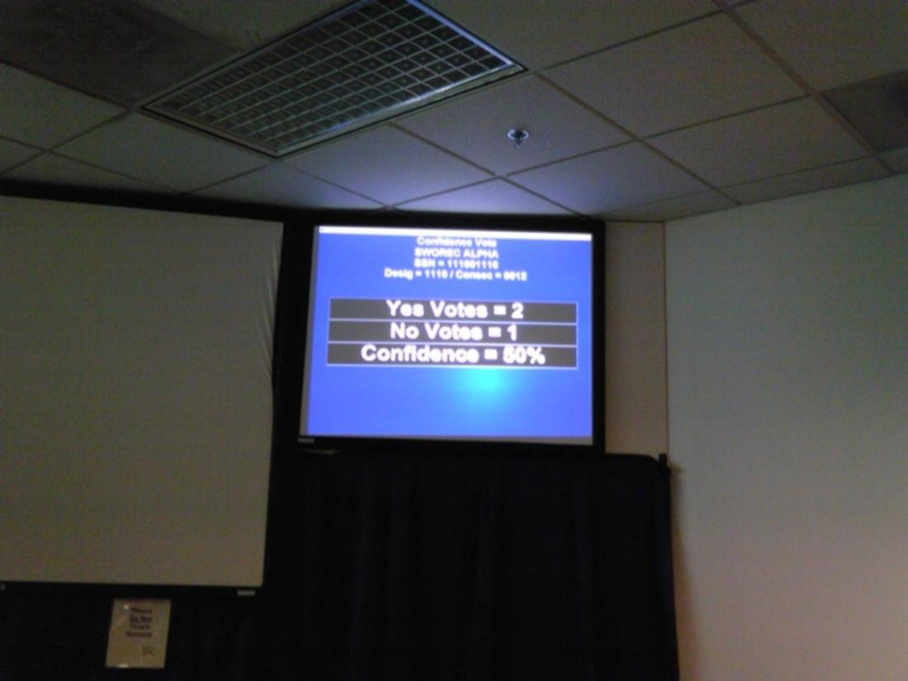
Voting Screen
Vote Screen
Not a real board

Slide 31
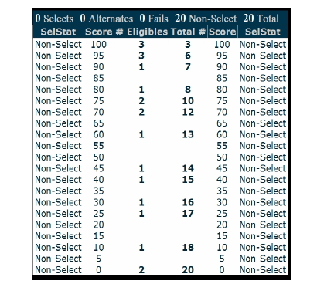
Scattergram

Slide 32
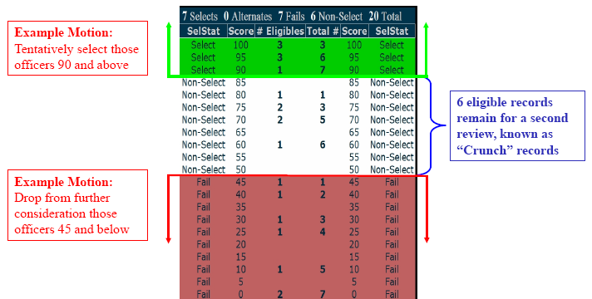
Scattergram Post-Motions

Slide 33
Merit Reorder Process
Allows boards to move up to 15% of selects to the top of the promotion order
“Officers of particular merit are those officers whose records contain documented performance consistently superior to the performance of other officers recommended for promotion by this board.”
Optional and not required

Slide 34
Board Results
Approximately 3 months after board
Name can be removed along the way
Select – CONGRATULATIONS!
  Strongly consider taking orders to a new command
Fail to Select – Time to regroup
  Review record with Detailer and Specialty Leader
  Plan next move
  FOS for LCDR – out after obligation served
    Retirement if eligible
    Separation: 7 months after release of results
  FOS for CDR – can stay 20 years
  FOS for CAPT – can stay 28 years

Slide 35
Recent Selection Board Observations
Soft breakout if 1/1 EP - “My #1 LCDR out of 25 of all designators.”
Forced distribution - “My #1 MP, would have been EP but ranked against highly competitive senior officers.”
If not getting the EP (air bubble) explain in the narrative (CO’s policy)
Make sure your board certification is reflected in subspecialty code (K)
Most important duty in block 29 box
New language emphasizing operational experience

Slide 36
Make Fitreps Easy to Read
Short opening statement – Breakout!
  “#3 of 15 LCDRs regardless of designator.”
  “If not for forced distribution and being junior LT…”
White space
Several bullets with most important listed first
  Cause and effect (impact) bullets
White space
Closing statement with promotion recommendation.
  Command recommendation if up for CAPT

Slide 37
Critical Fitrep Mistakes
Not getting an EP when you are 1/1
No one getting the EP
Declining from an EP to an MP without changing competitive groups (“moving to the left”)
Not getting a 5.0 in Leadership
Giving yourself a lower trait average than the reporting senior’s average

Slide 38
Performance Summary Report
REPORTING SENIOR
CUMULATIVE AVERAGE
All officers of that grade (regardless of designator) that the reporting senior has rated.
INDIVIDUAL TRAIT
AVERAGE
SUMMARY GROUP
TRAIT AVERAGE

Slide 39
Questions About “The Tank”?

Slide 40
Pace of Play - Career Progression
Promotion
Opportunity
Flow
Point
50-91%
CAPT (O-6)
18 yrs
65-85%
CDR (O-5)
12 yrs
100%
LCDR (O-4)
6 yrs
LT (O-3)
LTJG (O-2)
ENS (O-1)
Notes:
DoD requires that officers in all the services be similarly treated.
On the left hand side of the slide you see promotion opportunity for all officers (actually, DoD only specifies LCDR and above)
The FY01 opportunity for URL CAPT was 57%.
The FY01 opportunity for URL CDR was 70%.
The FY01 opportunity for URL LCDR was 85%.
On the right side the flow points or the promotion timing that should be followed by all the services are listed.
The FY01 CAPT flow point was 21-04
The FY01 CDR flow point was 15-07
The FY01 LCDR flow point was 10-03
The Navy promotes officers earlier than some of the other services.
AFQ means “all full qualified”. That is, all officers that are fully qualified for promotion whether in, or above, the promotion zone may be selected for promotion.

Slide 41

Five Career Paths
Academic
Administrative
Clinical
Operational
Research
All can lead to CAPT

Slide 42
FY20 CDR Promotion Stats
Promotion opportunity was 77%
In Zone
  92/174 – 53% selection rate
Above Zone
  38/137 – 28% selection rate
Below Zone
  4/308 – 1% selection rate

Slide 43
Promotion Opportunity & Zone
Set to maintain similar promotion opportunity every 5 years
Dependent on # of billets, retention/attrition
Eligible by Zone
Total Eligible
137 AZ
=311
Eligible
Officers
+
174 IZ
174 IZ x 77% = 134 Selects

Slide 44


Lieutenant/Lieutenant Commander
Board-certified
Fellowship
  Beware of timing
Deployment
  Beware of timing
Assistant/Associate Residency Director
DH in a small/medium MTF
Assistant Professor at USUHS
Publishing
Research
Departmental collaterals
Hospital committee member or chair
MEC member
Civilian leadership positions
SMO in a large MTF

Slide 45
Why Don’t People Make CDR?
PFA/BCA failures
Legal issues
Not board-certified
NOB fitreps while in residency/fellowship
Operational fitrep screw-ups
  2 MPs in a competitive group of 2
No competitive EP fitreps
  Wrong command
  Poorly timed deployment
  Late start to GME

Slide 46
FY20 CAPT Promotion Stats
Promotion opportunity was 81%
In Zone
  49/96 – 51% selection rate
Above Zone
  24/134 – 18% selection rate
Below Zone
  5/162 – 3% selection rate

Slide 47

Commander
Residency Director
DH in a large MTF
Associate Professor at USUHS
Director
OIC
Major committee chair
MEC member, VP, or President
Senior Operational Leader
  Division/Group/Wing Surgeon
  CATF Surgeon
  Amphib SMO
BUMED staff
Specialty Leader
Deployment requiring O-5
Detailer

Slide 48
Why Don’t People Make CAPT?
PFA/BCA failures
Legal issues
No senior leadership jobs
No overseas or senior operational tours
Didn’t get a 5 in leadership trait on FITREP
Not enough competitive EPs on fitreps

Slide 49

Captain
Senior Clinician
Residency Director
Director
XO/CO
Professor at USUHS
Senior BUMED Staff
  Deputy Chief of the Medical Corps
  Medical Corps Career Planner
OIC
Specialty Leader
Deployment requiring O-6
Senior operational leader
  MEF Surgeon
  COCOM Surgeon

Slide 50
What If I Fail to Select (FOS)?
Review your record with Detailer and SL
Meet with your chain of command
Consider sending a letter to the board whenever you are above zone
  Letter from you addressing the board
  Letters of support from senior people who can speak to your contribution to the Navy
  Specialty Leader is a solid choice if no other senior people stand out to you

Slide 51
Questions About Career Progression?

Slide 52
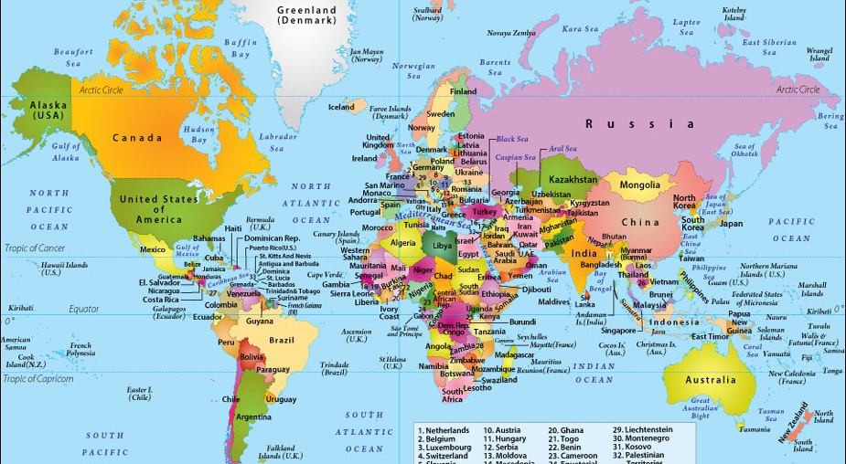
Team Schedule - Geographic Career Progression

Slide 53
Where Will I Go?
Negotiation between SL, Detailer, and you
  You talk to the SL and Detailer
Ultimate decision up to the Detailer
  Operational and overseas billets not supposed to be gapped
New way – Emergency Medicine Detailing Marketplace

Slide 54
What Affects Where/When I Can Go?
EFMP
PFA failures
Legal trouble
Time on station (TOS)
  Overseas and operational have no TOS requirement
Tour lengths
  Accompanied vs unaccompanied
  Specialty specific
  Geo bachelor orders
Cost
  OCONUS to OCONUS
Community manning level
  Double stuffs

Slide 55
Where Should I Go?
Overseas at some point
  Right after residency
  When seeking leadership positions
Post-residency operational tour
  Alternate between NMRTC/U and operational
“Homesteading” is not a negative for promotion as long as you progress in your career
  Negative in community
  Negative to me

Slide 56


Slide 57
Questions About Geography?

Slide 58
Final Advice
Actively manage your career
The Navy is about people
  Your list of influential, senior physicians in your specialty
  Detailer and Specialty Leader
Records, not officers, get promoted
  Joel Schofer’s Promo Prep (MCCareer.org)
Do everything you can to get competitive EPs leading up to the board
Be flexible
  Bloom where you are geographically planted

Slide 60
Contact Information
Cell – 302-824-4411
MCCareer.org
Joel.M.Schofer.mil@mail.mil
jschofer@gmail.com

