Slide 1
Outside the Box Opportunities
Joel M. Schofer, MD, MBA, CPE, FAAEM
CDR, MC, USN
Emergency Medicine Specialty Leader

Slide 2
Move After You Are Promoted
“Homesteading” is not a negative for promotion as long as you progress in your career
  Negative in community
  Negative to many Specialty Leaders
  Makes you a target with Detailers
Overseas
  When seeking leadership positions
Post-residency operational tour
Fellowships
Alternative tours (BUMED, BUPERS, etc.)

Slide 3
How to Get Out of Someplace You Hate
Time on station (TOS) requirements
  Overseas and operational billets have no TOS requirement
Global Support Agreement orders
  Deployment for 9-12 months with PCS Orders

Slide 4
Naval Hospital 29 Palms

Slide 5
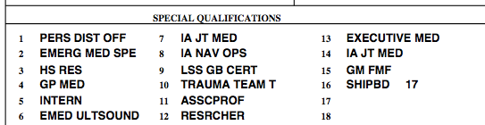
Additional Qualification Designators
They will not get you promoted
But they fill up your OSR and make your record look better
Some are important:
  Warfare qualifications/devices
  JPME I/II
  Executive Medicine
They will not get you promoted, but you might as well get as many as you qualify for

Slide 6
Joint Professional Military Education and War College

Slide 7
Master’s Degrees

Slide 8
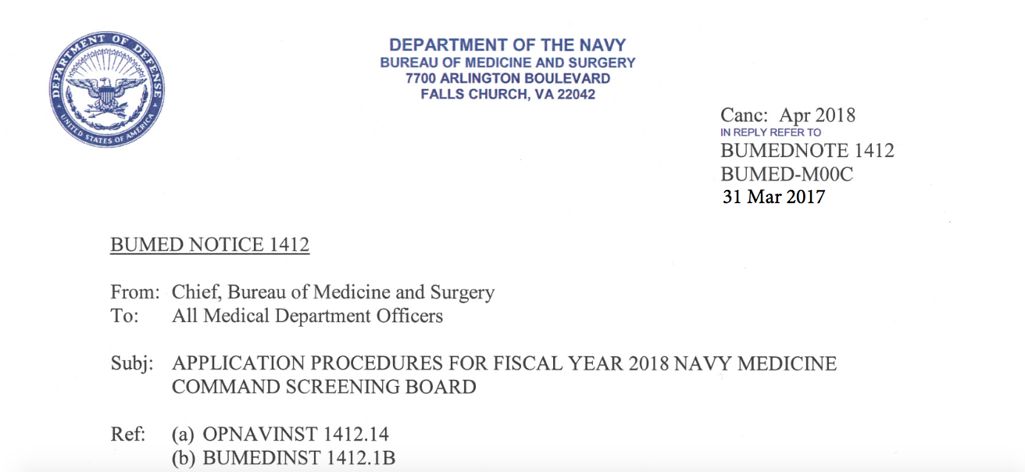
Chief Medical Officer and Officer-in-Charge Positions
https://es.med.navy.mil/bumed/m00/m00c/pages/executive-medicine.aspx

Slide 9
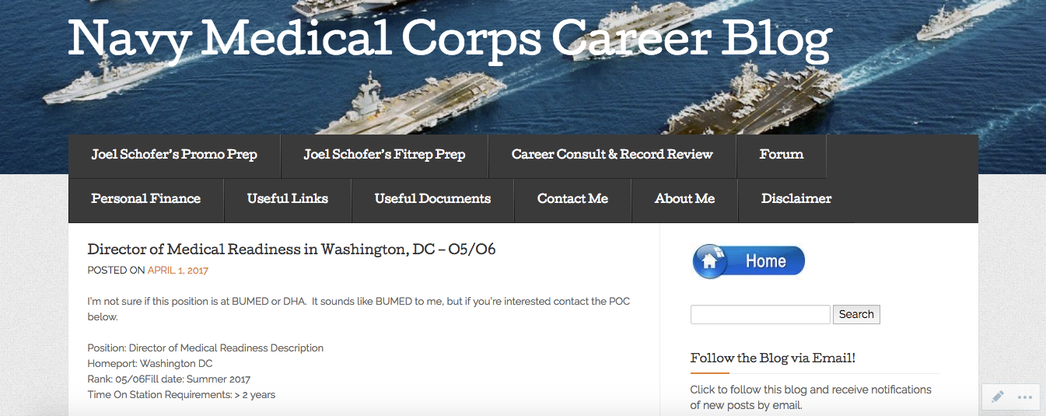
Job Announcements on the Blog

