Slide 1
Playing the Odds - Long-Term Care, Disability, and Umbrella Insurance - Do I Need All of This?
Joel Schofer, MD, MBA, CPE, FAAEM
Commander, Medical Corps, US Navy
Naval Medical Center Portsmouth

Slide 2
Military Disclaimer
The views expressed in this presentation are those of the author and do not necessarily reflect the official policy or position of the Department of the Navy, Department of Defense or the United States Government.

Slide 3
Bottom Line Up Front
Long-Term Care Insurance – probably don’t need it if you’re financially disciplined
Disability Insurance – might need it
Umbrella Liability Insurance – definitely need it

Slide 4
The Purpose of Insurance
To shift risk that you cannot bear to another entity

Slide 5
Long-Term Care Insurance
Protects against using assets to pay for prolonged nursing home or home health care
Medicaid ensures you won’t live in the street

Slide 6
Long-Term Care Insurance
Built on faulty models/assumptions
Sales are declining
Companies are exiting the market
Premiums rising, making many policies unaffordable
  More than 1/3rd of people let their policies lapse after age 65
Many companies no longer insure for an unlimited benefit period

Slide 7
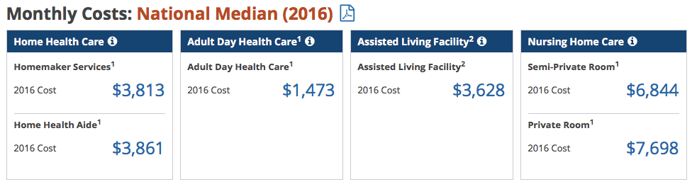
Monthly Cost of Care in 2016
https://www.genworth.com/about-us/industry-expertise/cost-of-care.html

Slide 8
Nursing Home Care
Among age 65+, 44% of men and 58% of women need nursing home care
Average stay is 11 months for men and 15 months for women
50% of stays for men and 39% for women are less than 3 months
  Usually covered by Medicare

Slide 9
Net Worth and LTC Insurance
Less than $1M - Medicaid
More than $3M – self insure
$1-3 M – consider LTC insurance

Slide 10
When to Purchase LTC Insurance
If purchased when young:
  Less chance of being rejected
  Lower premiums, but for a longer time
  More time for the company to change your policy or drop out of the market entirely
If purchased when older:
  Cancel life and disability insurance policies and put money toward LTC insurance premiums
Most common recommendation - purchase it in your late 50s to early 60s

Slide 11
Tips to Save on LTC Insurance
Purchase a policy that will cover a prolonged stay in a nursing home (greater than 3 years)
  Self insure with savings for a shorter period
Save with a longer elimination period (6 months to 1 year)
Decide how much of the daily fee you can afford on your own, and cover the rest with LTC insurance
Get a “shared benefit” rider that allows one spouse to share/use the other’s benefit, if needed

Slide 12
Where Can You Get It?
InsuringIncome.com
KaplanFinancial.net
MR-Disability-Insurance.com
PKAInsurance.com

Slide 13
Disability Insurance

Slide 14
Disability Insurance (DI)
Designed to replace income in the event you are disabled
10-20% of people will have a period of disability during their working life
Expensive – 2-6% of your benefit ($10K/month = $200-$600/month)
Complicated insurance product
  Definitions of “disability” vary
  Handle psychiatric disability differently (2 year max)
  Varying waiting periods for benefits to begin
  Many other issues

Slide 15
How Much Do You Need?
Most insurers will only give you 60-70% of your income
Most policies only pay up to the age of 65-67
How much income would you need if you became disabled?
How much do you already have saved for retirement?
As your net worth grows, your need will decrease

Slide 16
Definition of Disability
Specialty specific, own occupation
Psychiatric and substance-related conditions
  Commonly only cover 2 years of disability
  Can purchase more
Disability due to cosmetic surgery
Disability due to transplant surgery (donating)
Residual (partial) disability

Slide 17
DI for Women
Women pay higher rates than men because they are more likely to become disabled
  Their disability is more likely to lead to an inability to work
Unisex policies have the same rates for men and women
Available at some employers

Slide 18
Riders to Consider
Riders increase the cost and your agent’s compensation – buyer beware!
Future purchase option – allows you to purchase more insurance if your income rises
Cost of living rider – adjusts benefit for inflation once you start to receive it

Slide 19
Riders to Consider
Non-cancelable and guaranteed renewable rider – company cannot change anything about the policy
Catastrophic coverage rider – get additional money if so severely disabled you can’t do at least 2 activities of daily living
  Covers in-home medical care/assistance

Slide 20
WhiteCoatInvestor.com Rider Recommendations
Rider | Recommendation
Non-Cancelable/Guaranteed Renewable | Mandatory
Residual Disability | Highly recommended
Specialty specific (if necessary) | Highly recommended
Cost of Living Adjustment | Recommended in residency/early career
Future Purchase Option | Recommended in residency
Catastrophic Coverage | Recommended if inexpensive

Slide 21
You May Not Need DI if…
You’re financially independent
You have a high earning spouse
You’re active duty military
You have a rich family
You’re close to age 65

Slide 22
How to Purchase DI
Purchase from an independent agent that can sell you policies from multiple companies
Consider group policies once you’ve acquired as much individual coverage as you can obtain
Purchase when you are younger as it will be cheaper and the younger you are the more you need it (in residency)
Purchase before you develop risky hobbies or medical problems
Many policies will give you a discount if you pay in an annual lump sum

Slide 23
Where Can You Get It?
DI4MDs.com
PhysicianFinancialServices.com

Slide 24
Umbrella Liability Insurance

Slide 25
Umbrella Insurance
Covers non-occupation related liability
Supplements
  Renter’s insurance
  Homeowner’s insurance
  Auto insurance
  Boat insurance

Slide 26
Do You Need Umbrella Insurance?
Yes!
You can be sued for all of your assets
You can be sued for future income
You need to insure against this by:
  Increasing the liability on your auto/homeowner’s/renter’s to $300K-$500K
  Purchase umbrella insurance on top of it

Slide 27
How Much Umbrella Insurance?
Enough to cover your assets
Enough to make it unlikely the amount will be exceeded in a court judgment
Probably need $1-5M
Inexpensive - $200-300 for each $1M of coverage
  I pay $688.35/year for $3M of coverage

Slide 28
Where Can You Get It?
You can usually purchase it from the company who provides your other insurance

Slide 29
Bottom Line Again
Long-Term Care Insurance – probably don’t need it if you’re financially disciplined
Disability Insurance – might need it
Umbrella Liability Insurance – definitely need it

Slide 30
References
HumbleDollar.com
Martin T, Larson P, Larson J. Doctor’s Eyes Only: Exclusive Financial Strategies for Today’s Doctors and Dentists. 2012.
WhiteCoatInvestor.com
https://blog.foxwealthmgmt.com/2016/07/12/should-you-buy-long-term-care-insurance/
https://blog.foxwealthmgmt.com/2016/07/12/when-do-you-buy-long-term-care-insurance-video/

Slide 31
Questions?

