Slide 1
Teleconsultation Program
Available to all deployed providers and to Independent Duty
Medical Technicians working under the authority of a provider
Consultations are answered 7 days a week
Recommendations are answered within 24 hours
Uses Army portal with participation by all branches of the military
Consultants are from all branches of the military (Army, Navy, Air Force)
POC is LTC (Retired) Chuck Lappan
charles.m.lappan.civ@mail.mil
(210) 295-2512, Fort Sam Houston, Texas
Revised 6 July 2016
The information in this PowerPoint may not be place in non – military websites

Slide 2
Teleconsultation Program Transition
Teleconsultations are sent to “utility accounts” using the Defense
Information Systems Agency (DISA) email protocol with a naming
convention of xx.consult.army@mail.mil
If you have previously used emails that used the Army Knowledge Online
(AKO) email protocol use the DISA format.
  Teleconsultations to the AKO format (xx.consult@us.army.mil) will bounce back to the deployed provider as undeliverable

Slide 3
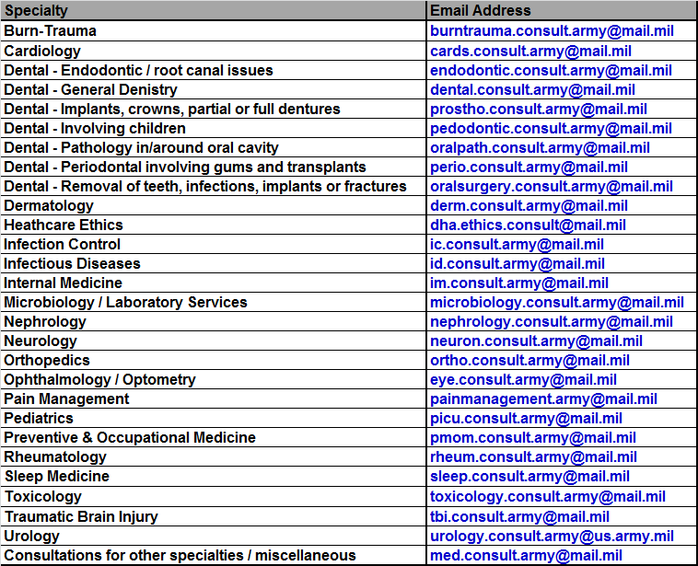
Teleconsultation Groups
Specialties organized into email groups

Slide 4
Teleconsultation Groups
Other specialties “as requested” – send teleconsultation to med.consult.army@mail.mil
  The following are examples of the “Other Specialties” that have assisted with
  teleconsultations
  This list is not all inclusive and may change without notice
  Allergy
  Endocrinology
  ENT
  Flight Medicine
  Gastroenterology
  General Surgery
  Hematology
  Legal
  Neurosurgery
  Nutrition Care
  OB-GYN
  Oncology
  Pharmacy
  Plastic Surgery
  Pulmonary Diseases
  Psychiatry
  Radiology
  Speech Pathology
  Vascular Surgery

Slide 5
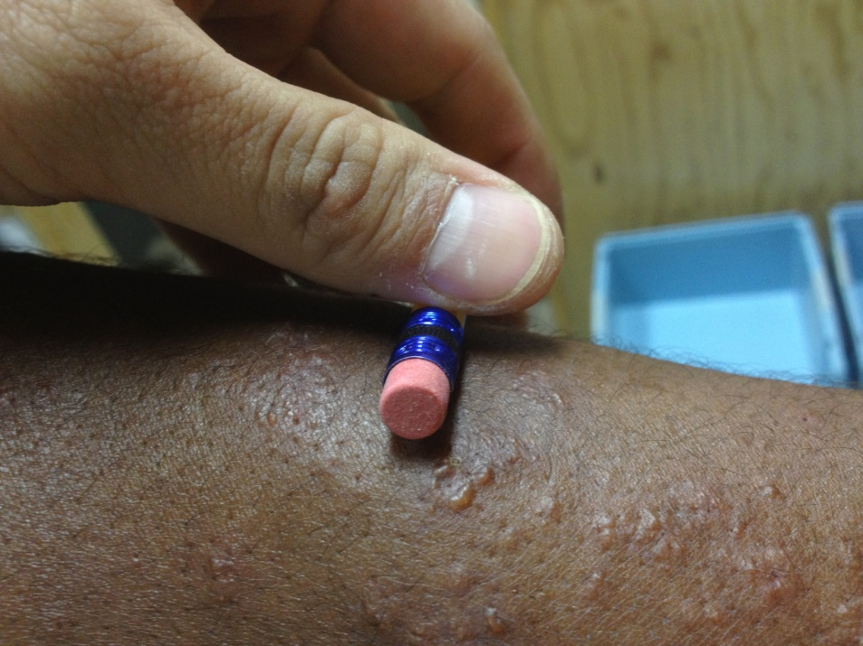
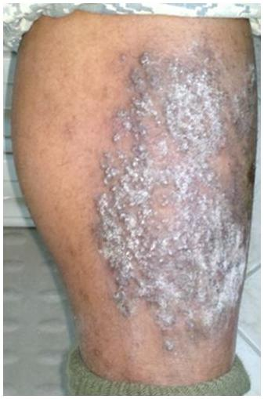
Cell-phone Cameras
Unless your cell-phone camera has good optics the image may not be acceptable
Apple iPhone 4s
Dx: Autoeczemation
Focal Length: 4.28 mm
F: 2.4
1/60th Second
Spot Metering
Droid 2 Global
Dx: Lichen Simplex Chronicus
Focal Length: 4 mm
F: 2.8
1/30th Second
Center Weight Average Metering

Slide 6
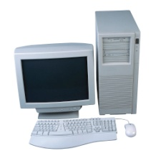
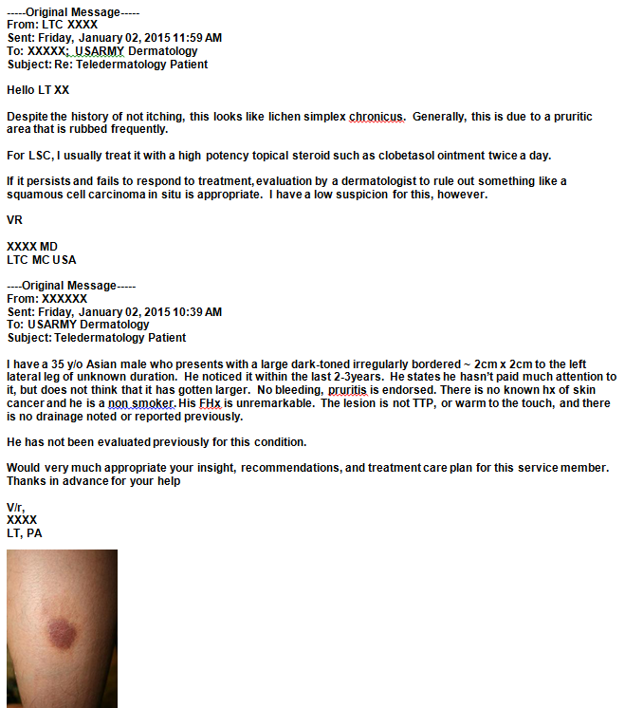
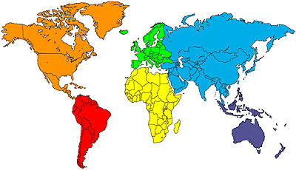


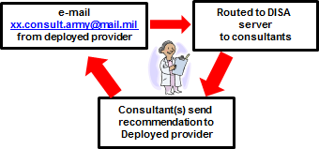

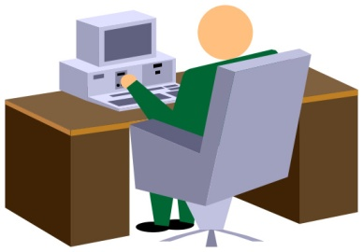

Teleconsultation Program Business Practice For Deployed Providers
Provider sends f/u or
questions/info to group
Specialty
with
Contact
Group
Deployed Provider
emails consultation
Yes
No
Include
charles.m.lappan.civ@mail.mil
in the “cc” address
Teleconsultation
is routed to the
appropriate
specialty group
Teleconsultation
emailed to
med.consult.army@
mail.mil
Finds consultant(s) with
appropriate
expertise
Consultant emails
recommendation
to the deployed
physician
Consultant
retrieves and reviews
teleconsultation
Copy furnished to specialty group… confirms teleconsultation is answered and enables collaboration

Slide 7
How To Send A Consult
Patient History
  When did it start? Days? Weeks? Months? Years?
  Patient symptoms now?
  Chronicity: Getting better? Worse? No change? Spreading?
  What was used to previously treat the patient?
  Effectiveness of previous treatments?
  Laboratory and Test results if any?
  Your Diagnosis and/or Differential Diagnosis
  Limitations you have treating your patient such as medications, procedures, lab tests?
Include Patient Demographics: branch of service, age, and gender. If not U.S. military list the
patient’s nationality. Identify if contractor, detainee, foreign military, etc
Include digital images if appropriate
  Use the jpeg format for images
  Check images before transmitting to ensure they are in focus and accurately portray the
  problem as you see it
  Usually 3 to 5 images is all we need
  When in doubt, overload us with images
Other attachments:
  PDF’s of EKG’s
  JPEGs of radiographs
  Laboratory and pathology reports

Slide 8
How To Send A Consult
Do not include patient identifying information such as the patients name or SSN
Try to limit one patient per teleconsultation
Do not send radiographs using the DICOM format
  Requires special processing
  Can delay the consultant’s recommendation(s)
Do not include “archive attachments / files
  Certain file types such as “.zip” are automatically blocked
If you send a consult and later need additional assistance send the teleconsultation to the
generic email address of the specialty and not to the consultant who answered your consult
  Most consultants are on a call-roster and look for consults during the period they are
  on-call
  Most delete the consult after they have answered it
  Project Manager makes an MSWord file for each consult
  When a reconsult is sent, the we transmit the file to the on-call consultant
The sender of the message sent the following file that is not allowed by NETCOM 2004-11A guidance: xrays.zip .

Slide 9
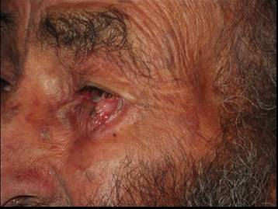
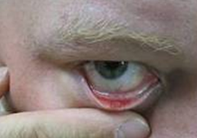
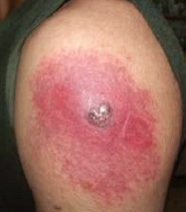
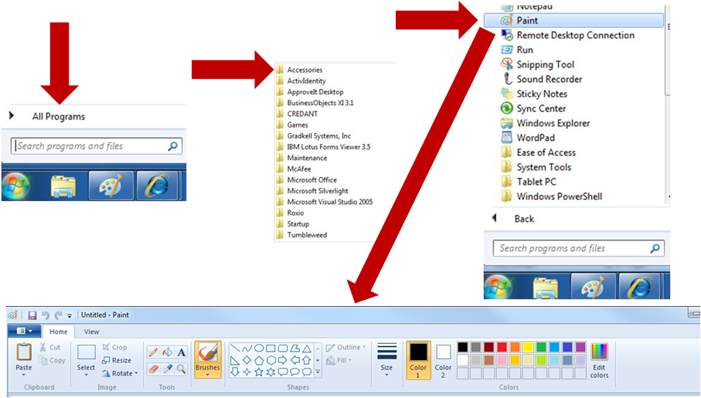
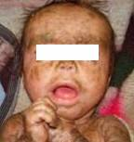
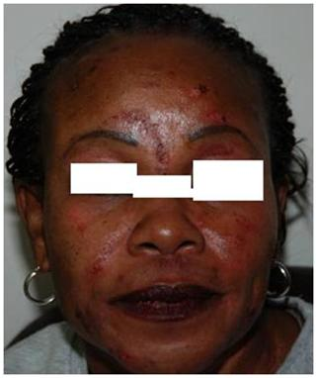
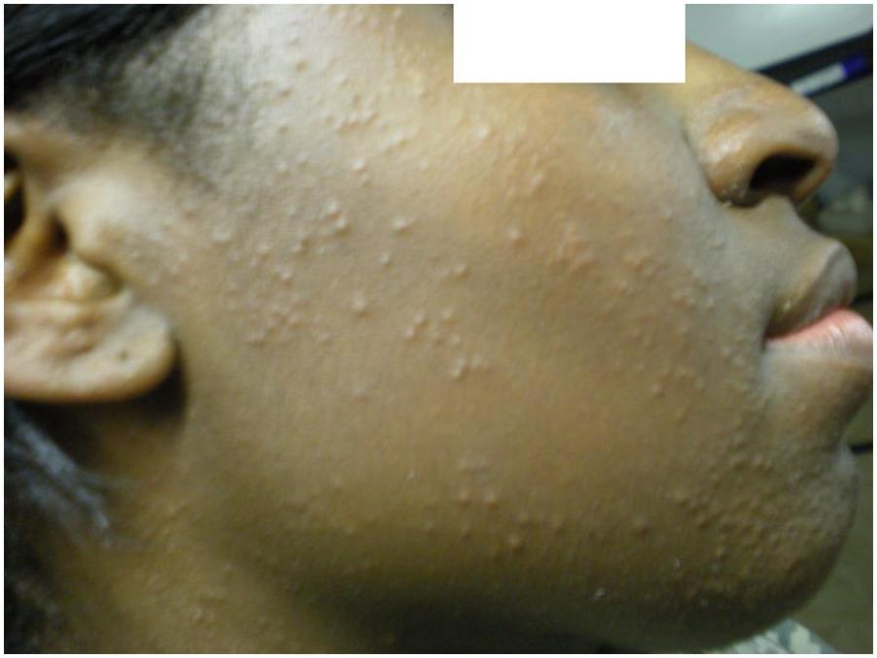
De-Identification and Protected Health Information
Digital images must obscure the face or identifiable markings
unless required for diagnosis
Bring the camera in
close and crop
Basal Cell
Carcinoma
Chalazion
Smallpox
Reaction
Use imaging the Microsoft
Office software to remove
identifying features
Lamellar
Ichthyosis
Acne Excoriee
Miliaria
Rubra

Slide 10
Potential Problems
Some servers block emails > 5 mB … some MTFs limit email sizes to 2 mB
Large files overload consultant’s email boxes causing their In-boxes to become full
  Try to keep your entire consultation under 10 mB
    Compress images before taking images – use the Menu / Set-Up in your camera
    If images are still too large after taking them – use Microsoft Picture Manager
    Do not compress to less than 50 kB … results in unacceptable pixilation when enlarged
Blurred images may be difficult to diagnose
  Use the macro lens (flower icon) for all close-ups and use the focus-lock technique
For questions on your camera please tell us the make and model number of your camera
If you send a teleconsultation and DO NOT receive a reply within 24 hours please contact
LTC (Ret) Lappan directly
  Teleconsultations can get hung up in either the in-coming or out-going email
  If the Consultant’s recommendation was sent but you did not receive it, we will resend it
  If we did not receive your teleconsultation we will expedite a recommendation to you

