Slide 1
Episode 31 - How to Read Your Performance Summary Report (PSR)
Joel Schofer, MD, MBA, CPE
CDR, MC, USN
MCCareer.org

Slide 2
DoD Disclaimer
The views expressed in this podcast are those of the author and do not necessarily reflect the official policy or position of the Department of the Navy, Department of Defense or the United States Government.

Slide 3
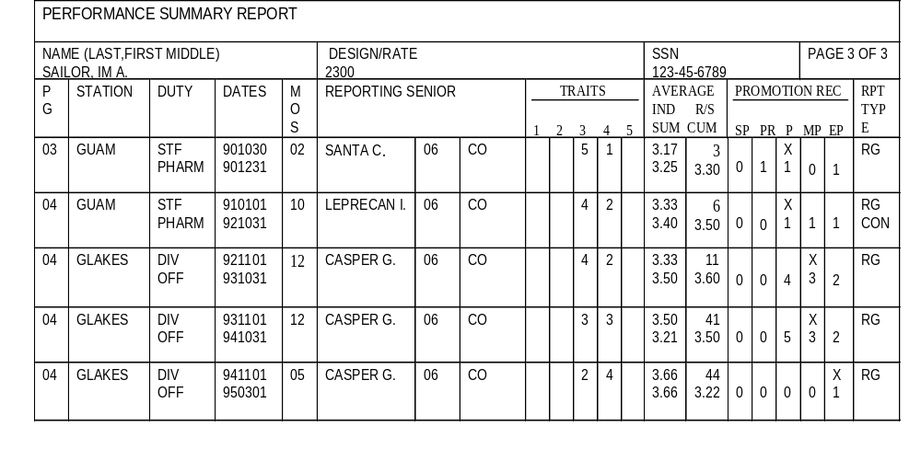
Performance Summary Report
FROM BOX IN BLOCK 29 OF FITREP
REPORTING SENIOR
CUMULATIVE AVERAGE
All officers of that grade (regardless of designator) that the reporting senior has rated.
INDIVIDUAL TRAIT
AVERAGE
SUMMARY GROUP
TRAIT AVERAGE

Slide 4
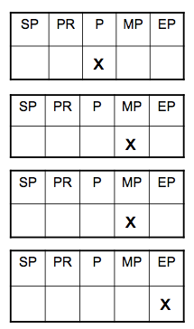
“Breaking Out to the Right”

Slide 5
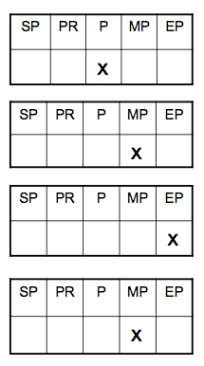
“Moving to the Left”

Slide 6
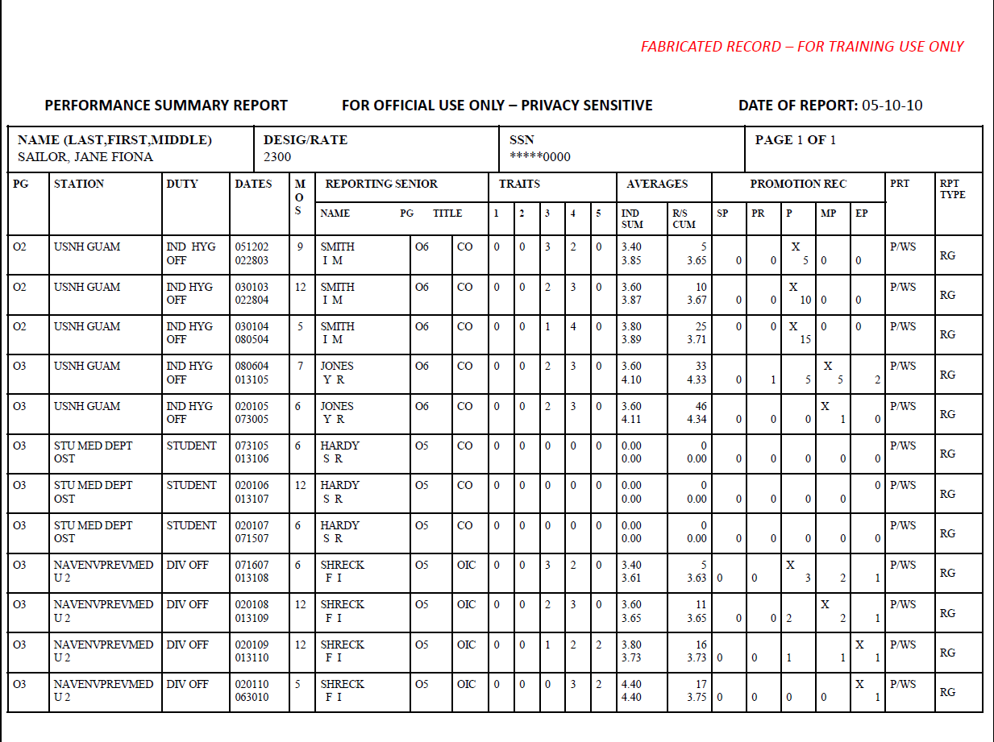
Air Bubble?
DUINS

Slide 7
Things to Look For on Your PSR
Make sure trait averages are accurate
Make sure promotion recommendations are accurate
Make sure PRT information is accurate

Slide 8
Questions or Comments?
Use the “Contact Me” tab on MCCareer.org
Post a comment on the blog post

