Slide 1
Episode 8 - Basic Anatomy of a FITREP
Joel M. Schofer, MD, MBA, CPE, FAAEM
MCCareer.org

Slide 2
Disclaimer
The views expressed in this podcast are mine and do not necessarily reflect the official policy or position of the Department of the Navy, Department of Defense, or the United States Government.

Slide 3
Importance of Your FITREP
Most important tool for documenting your achievements and potential for promotion
Physicians get very little education on how to write them.
FITREP instruction updated in 2015.
Grab your FITREP or get on NAVFIT98 and let’s go.

Slide 4
Blocks 1-4
Block 1 – Make sure your name is spelled correctly.
Block 2 - Use the standard abbreviations of CAPT, CDR, LCDR, or LT.
Block 3 – Enter your designator, likely 2100.
Block 4 – Make sure your SS# is accurate.

Slide 5
Blocks 5-8
Block 5 – All Active Duty will check “ACT.”
Block 6 – Enter your Unit Identification Code or UIC, which you can get from your Officer Data Card or orders on NSIPS.
Block 7 – Get the abbreviated name of your command from an old FITREP.
Block 8 – Put “SELECTED” if you’ve already been selected for promotion to your next rank, otherwise put “REGULAR.”

Slide 6
Blocks 9-13
Block 9 - In YYMMMDD format, enter the date you reported to your command. Example: 96OCT17
Blocks 10-13 – Place an X in each box that applies to this FITREP:
  “Periodic” – It is time for your regularly scheduled FITREP.
  “Detachment of Individual” – You are getting a FITREP because you are detaching from a command.
  “Detachment of Reporting Senior” – You are getting a FITREP because your reporting senior is detaching.
  “Special” – You are getting a FITREP for a special reason/circumstance.

Slide 7
Blocks 14-15
In YYMMMDD format, enter the beginning (FROM) and ending (TO) dates of the report period.
  Example: 96OCT17.
Regular reports: The FROM date must be the day following the TO date of the last Regular report. It can be earlier than block 9 if en route leave, travel, or TAD are included.

Slide 8
Blocks 16-19
Block 16 - If this is a wholly Not Observed (NOB) report, enter an “X” in block 16.
  The trait grades must be left blank, no career recommendation is permitted, the promotion recommendation must be NOB, and the promotion recommendation summary must be left blank. In addition, the Member Trait Average and Summary Group Average blocks must be left blank. Comments are limited primarily to administrative and training information.
Blocks 17-19 - Place an “X” in the block that applies.
  Most of the time it’ll be a Regular FITREP, unless you are deployed and then it’ll be Concurrent.

Slide 9
Block 20
Enter the one-letter code for the result of each official physical fitness assessment (PFA) conducted in the reporting period.
Document all official PFAs in block 20 using the following format: PPP. This indicates the individual passed three official PFAs during the reporting period. Do not enter spaces or slashes between the characters.
Format for block 20 shall be from oldest to most recent PFA performed during the reporting period.
  For example, PBF in block 20 and PFA: 10-1/10-2/11-1 in block 29 indicates that the member passed 2010 cycle 1, did not participate in the PRT portion of 2010 cycle 2, and failed 2011 cycle 1.

Slide 10
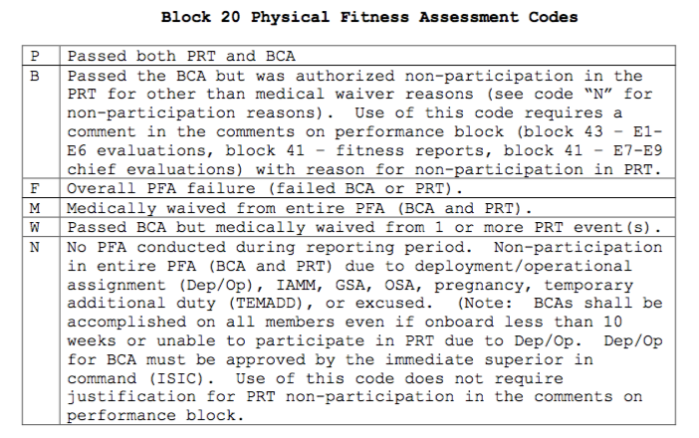
Block 20 Codes

Slide 11
Block 21
A very confusing block
Do not leave blank.
If you are an intern, put “Intern.”
If you are a resident, put “Resident.”
If you have RELEASED resignation or retirement orders, put “Approved.”
If you have been deployed in the last year or are currently deployed, look at the next slide to see if you meet the criteria to enter “Indiv Aug.”
  http://www.timeanddate.com/date/duration.html can help calculate the duration in days between two dates
Otherwise put “NA” and leave your leadership decide if they need to change it to “Basic.”

Slide 12
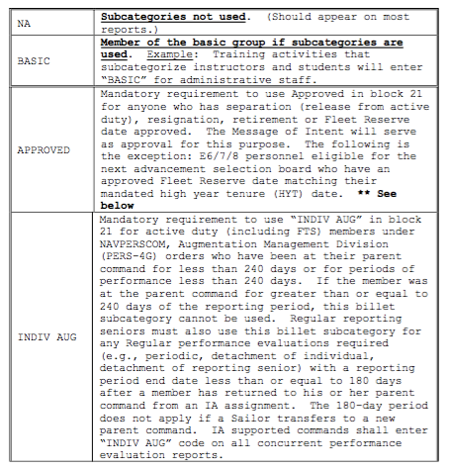
Block 21 Entries

Slide 13
Blocks 22-28
Get all of this info from old FITREPS or your chain of command

Slide 14

Box 29 – Primary Duty Box
THIS IS AN IMPORTANT BLOCK!
What you put here is displayed on your Performance Summary Record (PSR) and therefore at the promotion board.
In the small box enter an abbreviation of 14 or fewer characters and spaces for the MOST SIGNIFICANT DUTY for the period reported on.

Slide 15
Box 29
The remainder of block 29 consists of one to four elements, as follows:
  Duty Titles: Beginning to the right of the abbreviation box, enter duty titles and number of months each duty was assigned during this report period. Example: SENIOR MEDICAL OFFICER-7; EMERGENCY PHYSICIAN-7; CHAIR, CREDENTIALS COMMITTEE-3.
  Job Scope Statement: Briefly state the scope of primary duty responsibilities. Example: Provides bedside and didactic teaching for residents, interns, and medical students; maintains active clinical practice.

Slide 16
Box 29 (continued)
Periods Not Available for Duty: Identify any periods no duties were assigned. Such periods may include en route time prior to reporting, TAD, unusually long leave, deployments, etc. (If necessary to include maternity leave, identify only as "Leave.") Example: TAD 13OCT18-13NOV30; LEAVE/TRANSIT: 13JUN18-13JUL30.
PFA: Document specific PFA cycle(s) reported in block 20 utilizing the following format: PFA: 14-1/14-2/15-1. This indicates the PFA results listed in block 20 were attained during the 2014 cycle 1, 2014 cycle 2, and the 2015 cycle 1 official PFAs. No entry is required if no official PFA was conducted during the period.

Slide 17
Block 30
If mid-term counseling was received during the report period, enter the date counseled. Use YYMMMDD format. Example: 14FEB20.
If counseling was not performed because the counseling date did not fall within the report period, enter “NOT REQ” in block 30.
If counseling was not performed for any other reason, enter “NOT PERF,” and provide a brief explanation in block 31.

Slide 18
Block 31
Type the name of the counselor from the counseling worksheet.
If the entry in block 30 is NOT PERF, enter a brief explanation in block 31 (e.g., TAD or ILLNESS).
  If a longer explanation is needed, enter “SEE COMMENT” and provide an explanation in the block 41.

Slide 19
Block 32
You will sign this once your FITREP is done and sent back to you for review/signature.
The signature verifies that blocks 30 and 31 are accurate, but does not necessarily mean that the counseling was considered adequate.
An individual who believes that the counseling was inadequate may submit a statement to the record.

Slide 20
Blocks 33-39
Try and find out what your reporting senior’s trait average is for your rank.
Your chain of command either knows or can probably find out.
Reporting seniors can look it up on BOL.

Slide 21
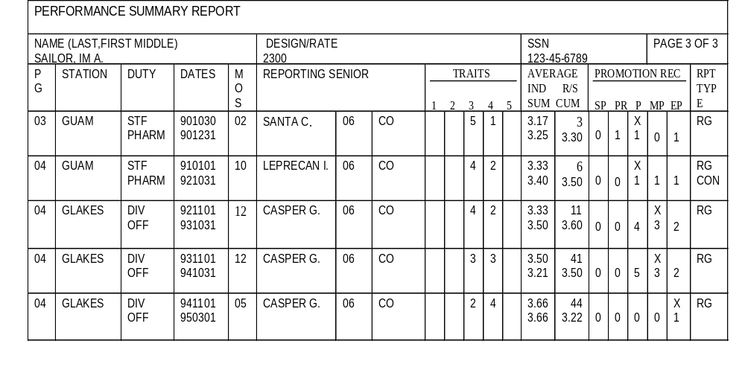
PSR & Promotion Boards
REPORTING SENIOR
CUMULATIVE AVERAGE
All officers of that grade (regardless of designator) that the reporting senior has rated.
INDIVIDUAL TRAIT
AVERAGE
SUMMARY GROUP
TRAIT AVERAGE

Slide 22
Blocks 33-39
Block 33 Professional Expertise – You generally get a 4.0 if you are board-eligible and 5.0 if you are board-certified.
Blocks 34-37 – Balance these out to give yourself the overall trait average you are looking for.
Block 38 Leadership – If there was any block you were going to give yourself a 5.0, THIS IS IT!

Slide 23
Blocks 33-39 (continued)
Grade block 39 NOB as it is likely not applicable to you.
Make sure you do not decrease in any of these from your last FITREP unless:
  You were selected for promotion.
  You were promoted.
  Your reporting senior or command changed.
You should still try not to decrease in any, but if the above situations are applicable it may be unavoidable.
Expect that your chain of command will alter whatever you give yourself, so my advice is to round up!

Slide 24
Block 40
Enter one or two career recommendations that are consistent with your rank and specialty.
Enter the next 2 jobs you want!
Do not leave blank.
Do not enter very long-range goals (e.g., do not recommend yourself for XO when you are a LT).

Slide 25
Block 41 - Style
Be concise as space is very limited. Don’t repeat block 29.
Bullet style is preferred.
Don’t mention your name.
Write in the past tense.

Slide 26
Block 41 – Style (continued)
Do not use abbreviations or acronyms without explaining them. Every promotion board has a line officer on it, and he/she needs to understand what you are doing so they can brief your record.
Quantify wherever possible in order to give credibility to the statements.
Make sure you don’t repeat bullets from your last FITREP. Your narratives need to read like a book that describes a growing Naval leader, not the same stuff over again.

Slide 27
Block 41 - Format
CDR Smith is my #1 CDR among 5 hand picked CDRs, many of whom are already selected for CAPT.
(one line of white space)
Bullet
Bullet
Bullet
Bullet
Bullet
Bullet
Bullet
(one line of white space)
CDR Smith has my strongest recommendation for promotion to Captain and executive medicine assignments.

Slide 28
Block 41 – What Not to Do
CDR Smith is my #X CDR among 5 hand selected CDRs, many of whom are already selected for CAPT. Bullet. Bullet. Bullet. Bullet. Bullet. Bullet. Bullet. CDR Smith has my strongest recommendation for promotion to Captain and executive medicine assignments.
Run-ons like this are too hard for board members to read.

Slide 29
Block 41 – Opening Examples
You may have to put something generic as some of these specific examples will be written by your command after all the FITREPs are ranked.
  If you are writing for an operational commander, you may be able to rank yourself.
Soft breakout - especially if your are getting a 1/1 FITREP. Get ranked against all corps/designators or across services.
  “My number #1 LCDR out of 25 of all designators.”
  “#3 of 15 LCDRs regardless of designator.”

Slide 30
Block 41 – More Opening Examples
“My #1 MP, would have been EP but ranked against highly competitive senior officers.”
“Would have been an EP but ranked against DCSS.”
“If not for forced distribution and being junior LT…”
  Comments like this are especially important at headquarters commands like BUMED where there is a large pool of “stars.”

Slide 31
Block 41 – Bullet Examples
CDR Y achieved diplomate status in the American College of Healthcare Executives. Increased preparation for Executive Medicine positions.
LT X is certified by American Board of X. Only 10% of Navy _____ have earned this elite designation.
LCDR Z increased clinic visits by over 200 per quarter and decreased referrals to the network by X%.

Slide 32
Block 41 – More Bullet Examples
LCDR X developed XXXXXX clinical pathway and saved $X dollars per patient.
LT Z attended training in XXXXX and enhanced her already strong skills in XXXXX.
LCDR X was a member of the XXXX committee and achieved…
Created a 70% cost savings totaling $750K/year compared to outsourcing.

Slide 33
Block 41 – Bullet Tips
Clinicians – focus on how you contributed to MTF optimization, increased enrollment, improved access to care, improved customer satisfaction, etc.
Researchers – focus on the impact of your work on DoD and the Navy, not the science.
Put your leadership in your profession into context that the board will understand.
Be part of your command. Mention command-wide issues and collateral duties.
Discuss mentorship and how you impact others.
Make sure your bullets show growth and increased responsibility.
Mention awards, like Medical Officer of the Quarter, etc.

Slide 34
Block 41 – Closing Tips
Always end with a recommendation on the next promotion and assignment/position.
If you are in-zone for O6, you should try to include an Executive Medicine recommendation.

Slide 35
Block 41 – Specific Comments
Enter reason for non-participation in the official PRT if the code letter in block 20 is “B.”
On a detachment of individual report, identify the next assignment, if known, to assist users in following the continuity of the record.
If you are in Full-Time Outservice Training (FTOS), make sure you have your program/fellowship director create a narrative to cut/paste into your NOB FITREP as block 41.

Slide 36
Block 42
Place an “X” in the box for the promotion recommendation.
Give yourself an EP if you are 1/1.
Do not downgrade yourself.
This will likely get changed by your chain of command, but if I was you I’d give yourself 1 higher grade than you think you deserve!
Make sure you “break out to the right” and don’t “move to the left” on your PSR.

Slide 37
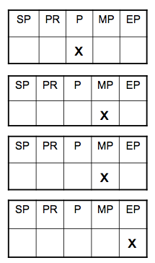
“Breaking Out to the Right”

Slide 38
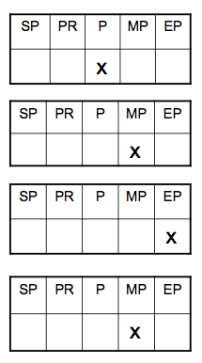
“Moving to the Left”

Slide 39
Blocks 43-45
Block 43 – This will be added up by your command once all the FITREPs are done.
Block 44 – Get this address from your old FITREP or your chain of command.
Block 45 – Your trait average will be here, but you won’t know the summary group average (and whether you are above or below it) until all the FITREPs are done.

Slide 40
Block 46
Filled out when your FITREP is returned to you for review before signature.
If you have questions about your FITREP, discuss those with your chain of command before you sign it.
Verify your name, social security number, and other administrative entries.
Check the box indicating your intention to submit or not to submit a statement, and sign and date all copies.
Use black or blue- black ink.
Your signature does not imply agreement with the report, but merely certifies you have seen the report and understand your right to submit a statement.

Slide 41
Block 46 - Statements
You may submit a statement on any report, whether or not the reporting senior considers it adverse.
The statement must be submitted within 2 years after the report ending date or provide acceptable justification for the delay.
Statements may be no more than two pages and may not have enclosures.
Statements must be temperate in tone and confined to pertinent facts.

Slide 42
Block 46 – Statements (continued)
They may not include accusations or countercharges, and may not question or impugn the motives of the reporting senior or other individuals.
Statements may not contain a request to modify, remove, replace, or investigate a report. Such requests may be made only as part of one of the appeal processes that exist.
The reporting senior will write a one-page endorsement that will be filed with the FITREP and your statement, and you’ll get a copy.

Slide 43
Block 47
If you are getting a concurrent FITREP, like when you are deployed, your regular reporting senior will sign here.

Slide 44
What is an Adverse Fitrep?
BUPERSINST 1610.10D
  Trait grade of 1.0
  Promotion recommendation mark of Significant Problems (SP)
  Command or Organizational Climate/Equal Opportunity trait graded below 3.0
  More than two traits graded as 2.0
  “Contains comments indicating serious weakness, incapacity, or lack of qualifications for promotion or assignment”
“A report shall not be considered adverse solely because it may make the member less competitive than another for promotion or assignment.”

Slide 45
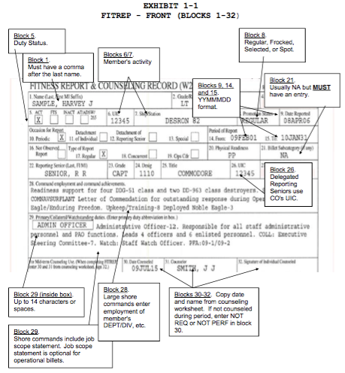
Blocks 1-32

Slide 46
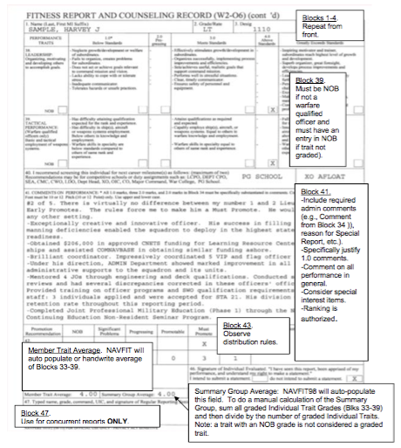
Page 2

Slide 47
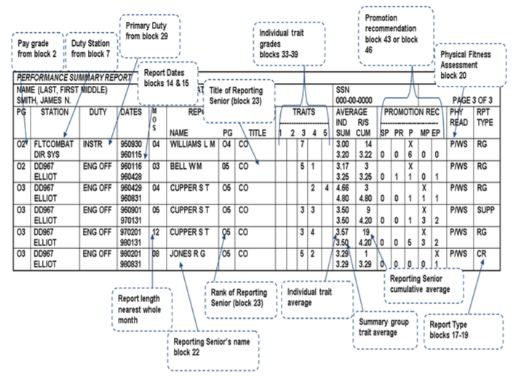
FITREP to PSR

Slide 48
References
Various Powerpoints
BUPERSINST 1610.10D

